Slide 1
Recognizing and addressing unconscious bias
Cat Adams // @ScienceIsMetal
Unconscious Bias Project // @UBP_STEM
Notes:
Thanks to Danny for the invitation to this fantastic symposium and you all for attending. It’s an honor to speak after so many great people working so hard to promote diversity in mycology!
I’m Cat. By day, I am the last PhD student of distinguished mycologist Tom Bruns, studying the chemical ecology of the death cap mushroom, Amanita phalloides. And on nights and weekends you can often find me and compatriots working to make the fields of STEM a truly level playing field.
Today I have just enough time to teach you what unconscious bias looks and a little bit about how to address it. I hope to leave you with an appreciation for how important this topic is for true equity and inclusion in STEM. I will definitely offer you with some evidence-based approaches to addressing bias, and at the end I’ll explain how to learn more if you’re interested in a more in-depth talk or workshop for your institution.

Slide 2
Bias:
prejudice in favor of or against
one thing, person, or group
compared with another,
usually in a way considered to be unfair.
@UBP_STEM
Notes:
To get started, let’s get on the same page about what bias is. Unconscious or implicit bias is prejudice in favor of or against one thing, person, or group compared with another, usually in a way considered to be unfair. Moreover you can have bias even though you don’t consciously agree with it or even know it’s there.

Slide 3
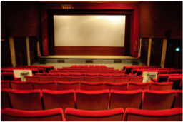
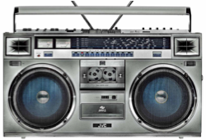
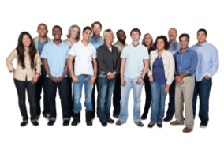
Negative stereotypes → unconscious bias
@UBP_STEM
Notes:
Most people don’t want to be racist or sexist, but a lot of us are unconsciously biased against certain groups anyway. This starts with negative stereotypes from the world around us: over-simplified generalizations about people that we see in TV shows and movies, hear on the radio, read in books and on the internet, and pick up from friends and family. Even if we don’t consciously agree with these stereotypes, they can still worm their way into our subconscious brains and influence how we think and act.
I’d like to call attention to a few key negative stereotypes…

Slide 4
Men as breadwinners
Women as caregivers
Beautiful women as not intelligent
Racial minorities as criminals
Asian people as good at math
Custodians as racial minorities
@UBP_STEM
Notes:
Historically, men have worked while women stayed home with the children.
Women can be beautiful or intelligent, but not both.
And African Americans are commonly portrayed as criminals.
Positive stereotypes can be just as hurtful, like that Asian people are good at math.
Bias can even come from simple associations of patterns we notice unconsciously, like that custodians are often racial minorities.

Slide 5
Low health
(Lee et al 2016)
Depression
(Cox et al 2012)
Aggression
Decreased performance
Stereotypes hurt people
Inability to focus
Hypertension
(Blascovich et al 2001)
Over-eating
(Inzlicht et al 2010)
Anger, dislike
(Siy et al 2013)
@UBP_STEM
Notes:
Before stereotypes even lead to bias, stereotypes by themselves are damaging. Being stereotyped has been found to lead to short term aggression, inability to focus resulting in decreased performance, and over-eating.
People who regularly encountered the threat of being judged by negative stereotypes are more likely to have hypertension, be depressed, and to rate their own health more poorly.
Being at the receiving end of positive bias hurts too. For example, implying someone is likely good at math because they are Asian might make the victim dislike the speaker, and invokes feelings of anger.

Slide 6
Negative stereotypes
Unconscious bias
Barriers to entering STEM
Reasons for leaving STEM
Barriers to rising in STEM
@UBP_STEM
Notes:
When stereotypes lead to unconscious bias about who can thrive in science and tech, this leads to barriers to entering STEM fields, the so-called the pipeline problem.
The pipeline is only the beginning of the harmful effects of stereotypes. Once marginalized people get their foot in the door, unconscious bias also leads to barriers to rising in STEM.
Even when you’re successful, these harassing or unsupportive work environments are a common reason for leaving STEM.
Together, these barriers keep some groups underrepresented in STEM and reinforce the preexisting stereotypes, creating what we’ve dubbed the “positive feedback loop of negative stereotypes”

Slide 7
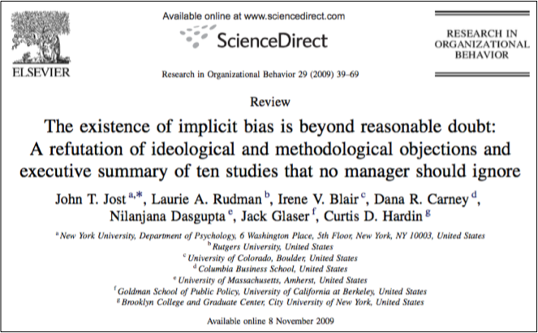
@UBP_STEM
Notes:
So to summarize several decades worth of research, I give you this iconic paper titled: The existence of implicit bias is beyond reasonable doubt.
As I started reading all this I confess I was surprised to learn that, like the so-called debate about climate change, among social scientists, the role of bias in holding back white women, people of color, queer folks, disabled folks, all sorts of under-represented minorities, is a non-issue. Unconscious bias is real, and it is impacting diversity and inclusion.

Slide 8
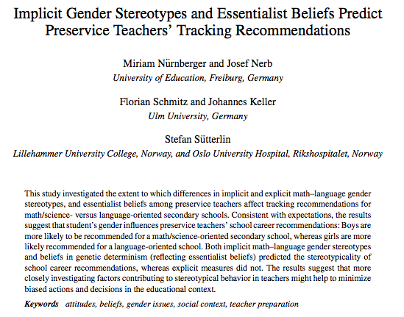
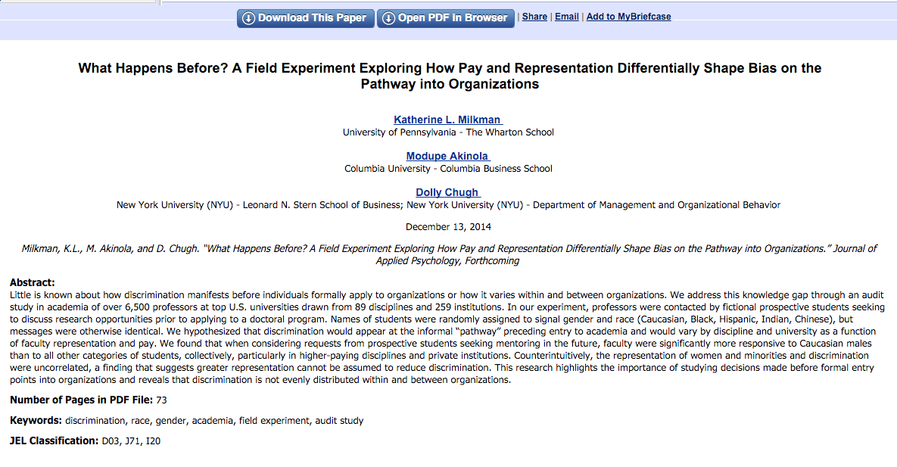
Notes:
This talk is short, so paper abstract lightning round!
Bias in how teachers treat male and female elementary school students.
Bias in whether or not professors respond to emails. There are a number of papers documenting bias in the peer review process.
Bias in how many female students are employed by high-achieving male faculty.
There’s documented evidence of intersections of bias too, like bias against women with children and specific flavors of bias against women of color.

Slide 9
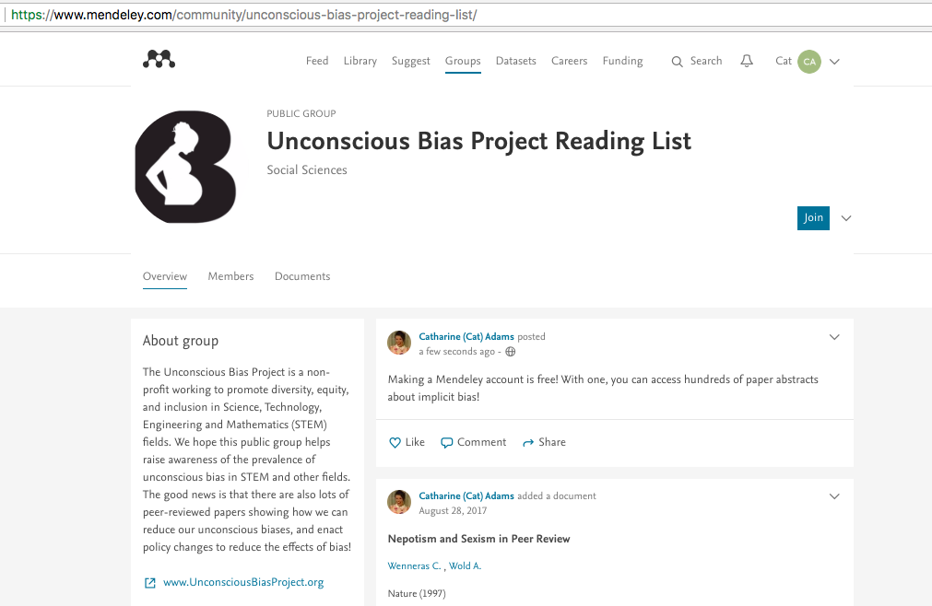
Tinyurl: https://tinyurl.com/yb4x7bg2
Notes:
And if you don’t believe me or want to read up more on the topic, this group I started now has a public mendeley folder that anyone can access to browse titles and abstracts.
Our undergrad Vishal is adding even more articles this summer from his parents house in New Jersey.

Slide 10
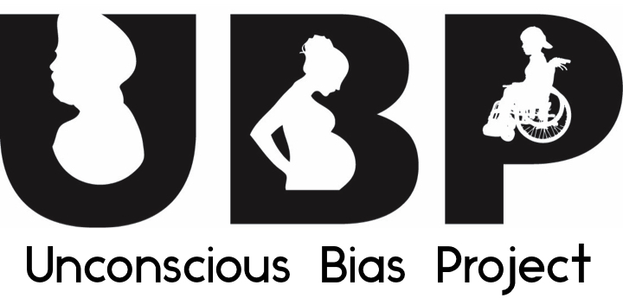
@UBP_STEM www.UnconsciousBiasProject.org
Notes:
Speaking of resources we’ve created…
Unconscious Bias Project, or UBP, is a registered 501 CS non profit working to help raise awareness about unconscious bias in STEM, and to promote evidence based approaches to reduce bias and its consequences.

Slide 11
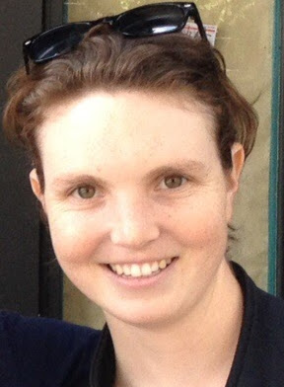
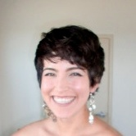
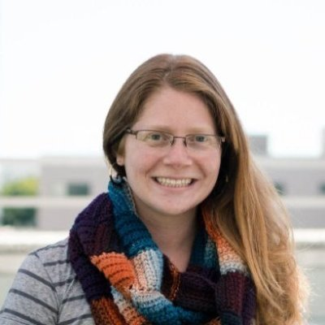
Our leadership and speakers
Linet Mera, PhD
Career and Professional Development Consultant, UCSF and WUSTL
Molecular Biologist with PhD from UCSF
Anna Schneider, PhD
Data Scientist, Stitch Fix
Co-founder and former CTO, WattTime
Forbes 30 Under 30
Emily Kearney
PhD Candidate, UC Berkeley
Co-founder, Project SaFE (Safety and Field Equity)
BS in Ecology and Evolutionary Biology, Cornell University
Lanie Petersen
Vet Tech, Steinbeck Country Equine Clinic
BA in Sociology, St. Mary’s College of California
Notes:
And by no means am I doing all this work alone. I’m privileged to work with several awesome people in the Bay Area to develop materials and give workshops about bias, and there are dozens more people that have worked with us and supported us over the last 3 years. We are mostly scientists, working to translate the findings from social psychology to our fellows in STEM, and promoting solutions that are both evidence based and directly relevant to the people in the audience.

Slide 12
Words
Policy
Thoughts
@UBP_STEM
Notes:
For example, in our talks and workshops we generally propose 3 approaches to address implicit bias.
Words you can say when you find yourself in a situation where someone else is acting with bias.
Policies can make it easier for people in your organizations to act with less bias, like anonymizing applications for grad school or faculty positions.
And lastly there are ways to reprogram your thoughts and reduce your own unconscious bias,

Slide 13
Words
Policy
Thoughts
@UBP_STEM
Notes:
Briefly, thoughts:
With a show of hands, who in the audience has gone to some sort of diversity training that you found useful?
And how many of you have attended a diversity training you felt like was a big waste of time?
As it turns out, a bad training can not only NOT reduce bias, but can actually leave attendees with MORE hostile attitudes towards people that don't look like them. A bad training makes people more aware of our differences, without giving mental strategies to reconcile those differences. I think a lot of backlash towards “diversity trainings” is pretty warranted, and so at UBP we’ve been very careful to only promote evidence-based approaches.
And based off the peer reviewed psychology literature we know that there are pre-reqs to being able to reliably reduce bias.

Slide 14
Motivated to overcome bias
Aware of your bias and why it exists
https://implicit.harvard.edu
Able to detect the influence of stereotypes
Learn and practice strategies to reduce bias
@UBP_STEM
Notes:
These pre-reqs are as follows:
1) You are motivated to overcome your bias. That’s why we always make sure our talks thoroughly define the problem of bias.
2) You become aware of your bias and why it exists. There is a very useful online test called the Implicit Association Test, which you can find at projectimplicit.net. This test measures microsecond differences in how quickly you associate certain terms with different groups of people. It’s not a perfect assessment, but it drives home that idea that bias comes from automatic associations that our mind builds, and can be in opposition to our conscious thought.
3) You learn to detect the subtle influence of stereotypes, which helps you be ready to act and know how to act.
4) You learn and practice strategies that help reduce automatic bias - yes, you have to practice, without it, there will be no change.

Slide 15
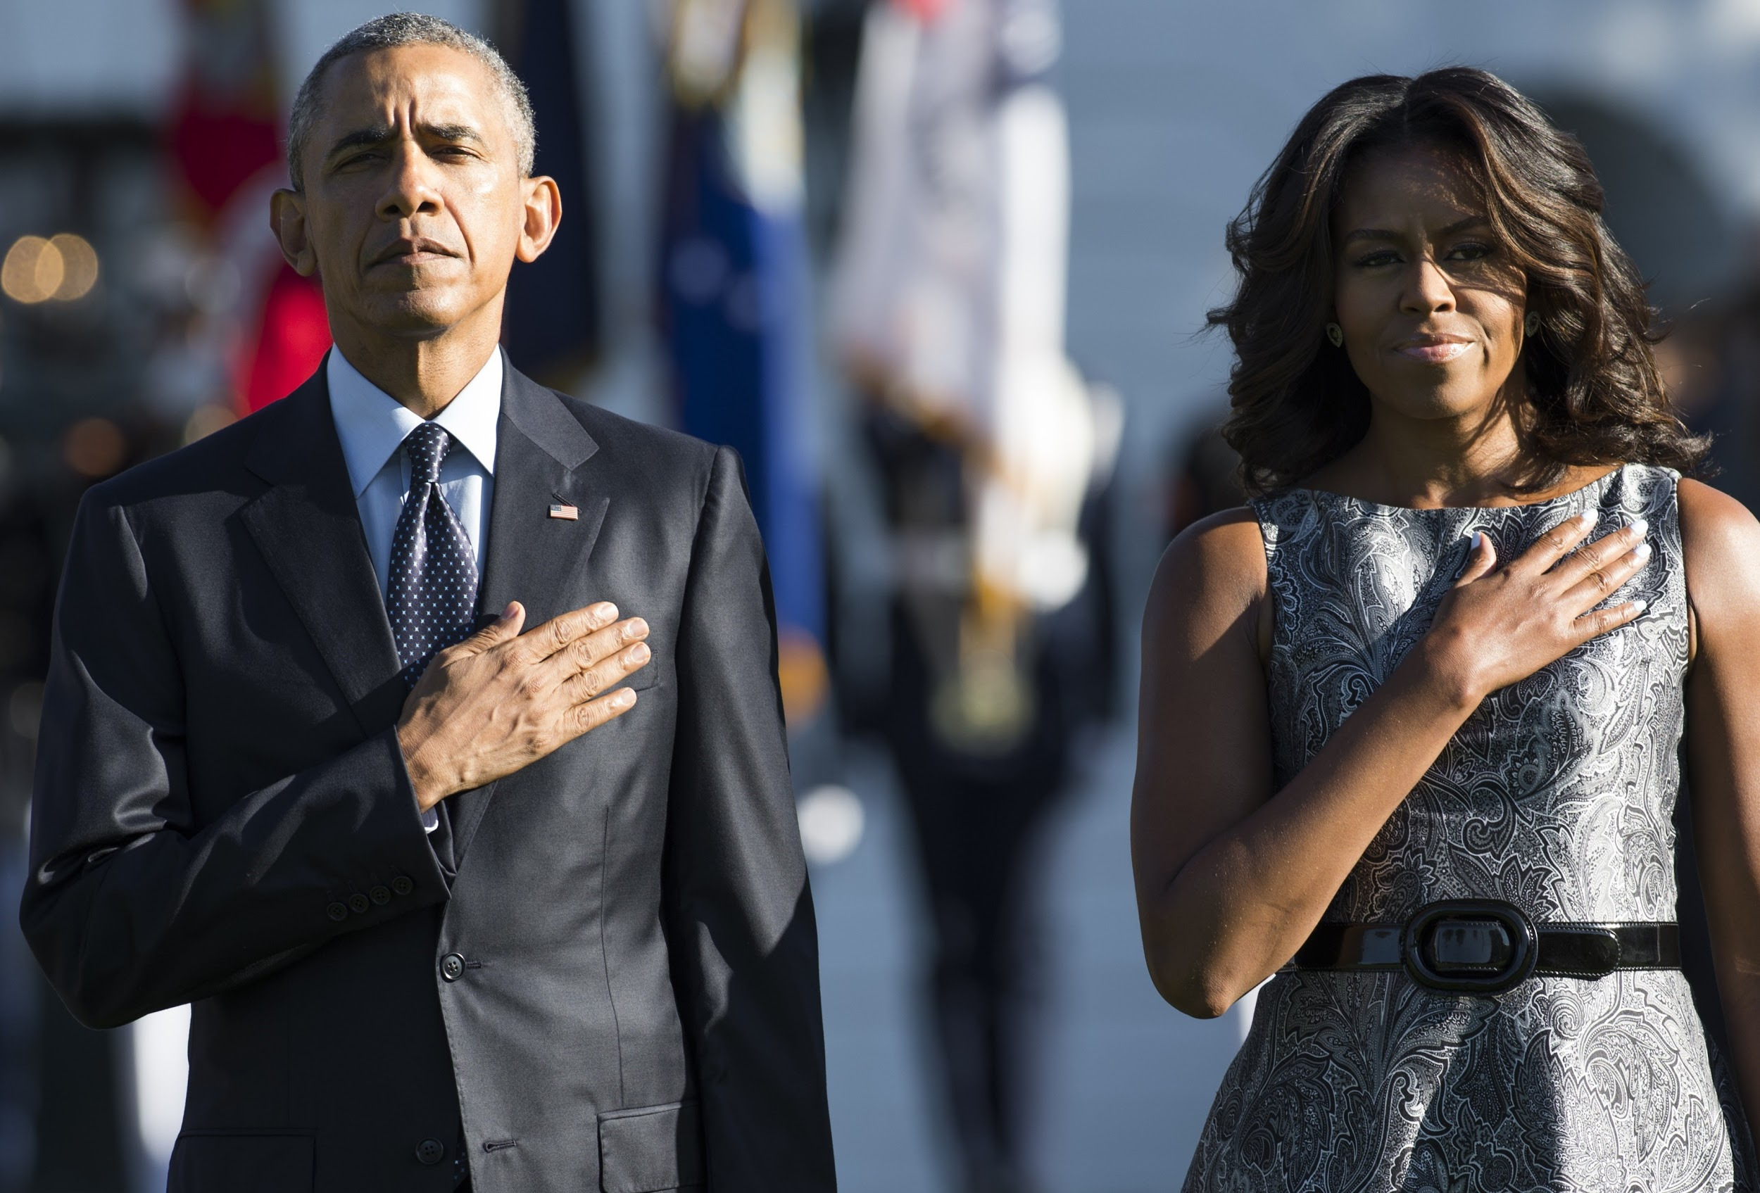
Counter-stereotypic examples
@UBP_STEM
Notes:
One example of an effective strategy is thinking of counter-stereotypic examples. When you notice yourself thinking a stereotypic thought, or if you’re presented with a stereotype, picture a counter example to that stereotype. The counter-stereotype who can be a friend, a famous person, or a fictional character.
One paper found that conjuring an image of former US president Barack Obama after exposure to an anti-Black stereotype can be enough to reduce how much someone acts with bias, which is pretty cool.

Slide 16
Words
Policy
Thoughts
@UBP_STEM
Notes:
Lastly, words. It’s really important to speak up when others vocalize bias. Over the years, we’ve been working with an amazing cartoonist Theresa Oborn to illustrate real scenarios that come up.
We have a lot of cartoons that cover many different flavors of unconscious bias, but today I have time to show you one.

Slide 17
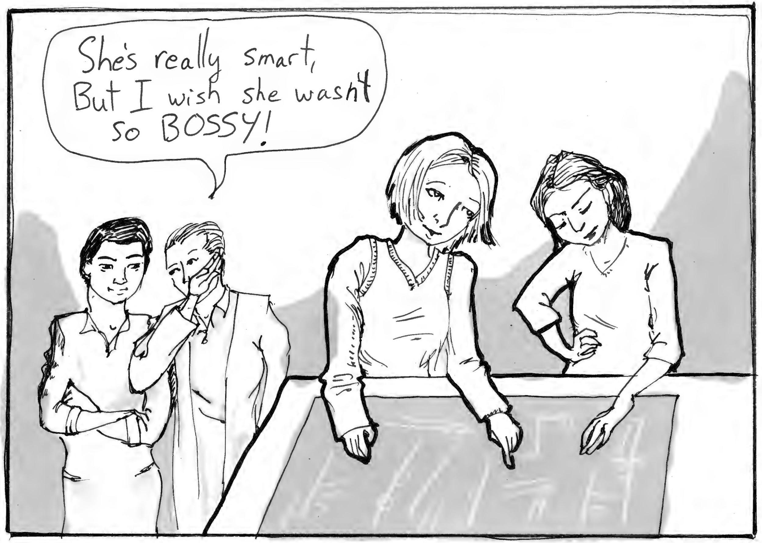
Ouch, that’s a bit harsh.
@UBP_STEM // @tobornthegreat
Notes:
Here’s one of her cartoons. Who’s heard this one before? “She’s really smart, but I wish she wasn’t so bossy!” Yeah, I thought so, me too.
It’s been well established than the same sorts of leadership behavior are often interpreted very differently when displayed by a man vs a woman or non-binary person.
What are your options when someone says this to you? One option is to say nothing—it’s ok to pick your battles. Another option is to observe that the comment is stereotypical and hurtful, like saying “ouch, that’s a bit harsh”

Slide 18
She’s not bossy, she’s a leader!
@UBP_STEM // @tobornthegreat
Notes:
Another option is to redirect by countering the stereotype, like saying “she’s not bossy, she’s a leader!” A positive comment like this can help weaken the negative stereotype for those around you, without being too confrontational or derailing the conversation. Instead of a microaggression, this is a microaffection!

Slide 19
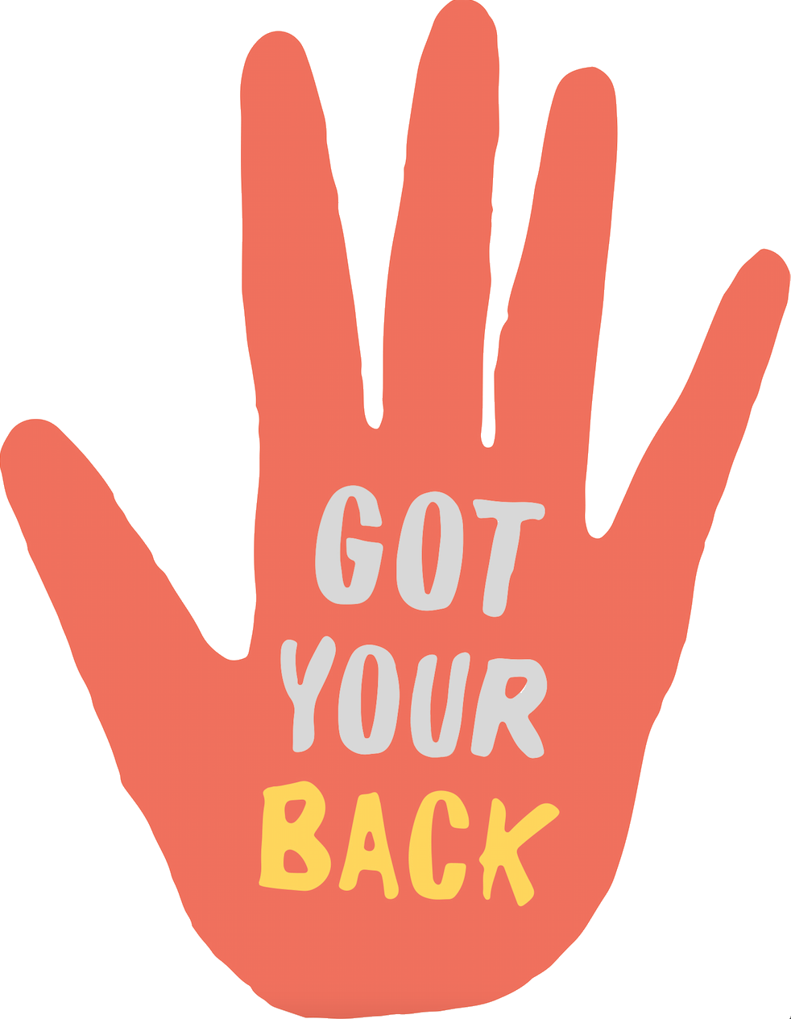
Interruptions
Giving credit
Emotional support
Recon
@UBP_STEM // https://www.heygotyourback.com/
Notes:
If unconscious bias is a common occurrence in your environment, consider using the Buddy System. That can make sticking up for your coworkers like in the previous cartoon even more powerful.
To use the buddy system, simply find a buddy. Maybe you have a secret handshake, or a decoder ring. Anyways, once you have your buddy, you and your buddy can remind each other before meetings or events to be on the lookout for bias. A bias buddy is strongest when you’re different races, genders, religion, etc. A bias buddy can do many things! For example:
Interruptions: “I want to hear what Sarah has to say.”
Credit: “Ahmed just said that 15 minutes ago.”
Emotional support: “She was a real jerk to you in there.”
You can also get recon after the fact.
If you witness someone say something biased but are unsure about what the victim actually wants in the moment, you can check in with them afterwards and ask them what they would appreciate you saying in the future. This might be an especially good strategy if you witness someone with a disability receiving bias, and you don’t want to come off as patronizing, and/or you are unsure about how the disability affects them.

Slide 20
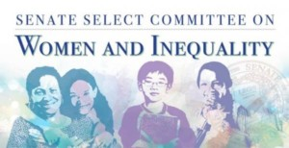
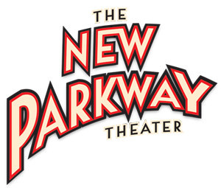
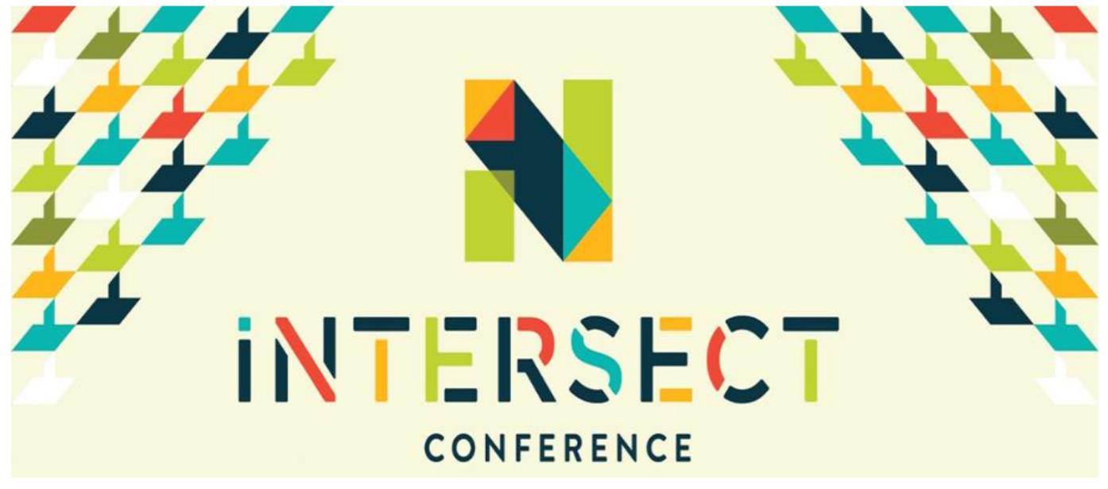
Past venues and clients
Notes:
We’re really excited to be growing our membership so we can reach even more people. If you are interested in joining us, please take my business card.
We’ve given a lot of talks already. If this I have a call with Microsoft the day after I get back next week, and they’ve got money so we charge them corporate rates, but we’re not in this to make money. We just want to make STEM better, and so we don’t charge academics nearly as much as the tech companies.
Your institution could be next!

Slide 21
Unconscious bias is real
Unconscious bias solutions are real too
We all have a role to play
@UBP_STEM
Notes:
And with that, let’s wrap it up. Yes, unconscious bias is a real problem. And yes, ways to reduce unconscious bias are real too. No matter what roles we play in different situations and different organizations, we each have options for what to say in the moment when we see or experience unconscious bias, and what policies we can advocate for that can guide everyone towards less bias. And even though most of us have unconscious bias, those biases don’t own us. With dedication, we can practice breaking the bias habit and becoming closer to the people around us, and becoming closer to the people we want to be.

Slide 22
Cat Adams|| @ScienceIsMetal
UnconsciousBiasSTEM@gmail.com
UnconsciousBiasProject.org || @UBP_STEM qqqqqqqqq
Anna Schneider, Linet Mera, Emily Kearney, Lanie Petersen, Theresa Oborn, Aaron Culich
Notes:
One last time I want to remind you that we have an ever-growing list of resources on our website, so please don’t hesitate to reach out with questions or comments or stories that can be made into bias cartoons.
Thank you all for your attention, and I’m happy to take questions.

Slide 23
Donations are tax-deductible!

Slide 24
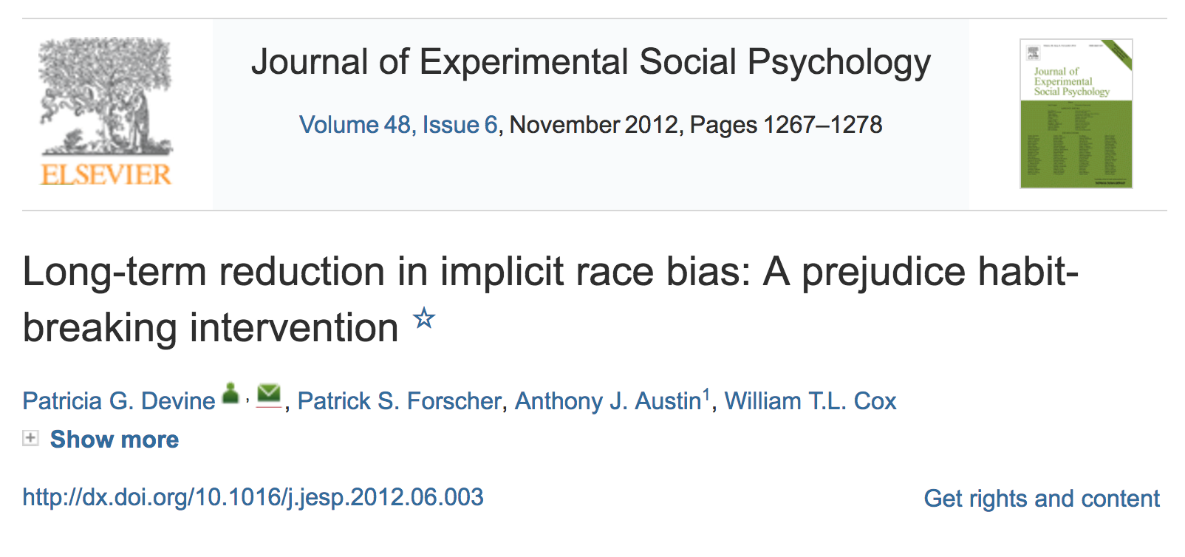
@UBP_STEM
Notes:
For example, while researching, we came across this fantastic paper.
In a controlled lab setting, these researchers found their training worked to reduce unconscious bias for at least 3 months!
So, we contacted them, and they sent us all their materials, and we’ve given the workshop to a few different groups now. Attendees just have to bring a laptop and 90 minutes of their time, and afterward they are statistically likely to have less bias. It’s amazing!
One of the reasons it seems to be soo effective is that attendees leave with an increased concern about unconscious bias, which encourages them to continue applying the mental exercises they learned in the workshop, thus continually reducing bias over time.
Now I'd like to distill their entire paper into the next 5 minutes for your take homes on how to change your own thoughts.
There are certain prerequisites necessary to reliably reduce bias:

Slide 25
Barriers to entering — biased teachers
@UBP_STEM // http://dx.doi.org/10.1080/00220973.2015.1027807
Notes:
This bias starts at a very early age, and happens around the world (this paper is from Europe). Here, the researchers showed that teachers have both conscious and unconscious stereotypes about boys being better at math and girls being better at languages, and those stereotypes influence whether the biased teachers recommend boys and girls for math and science vs language oriented schools.

Slide 26
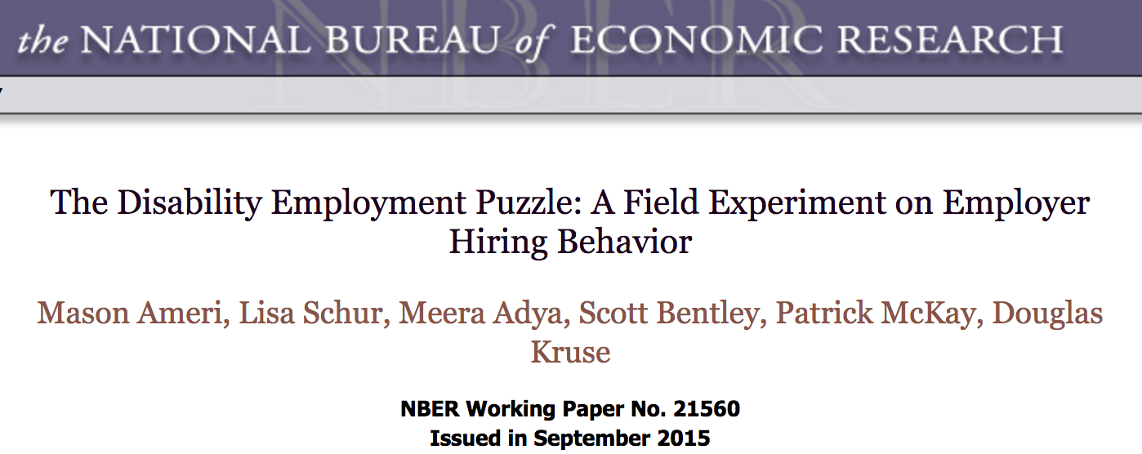
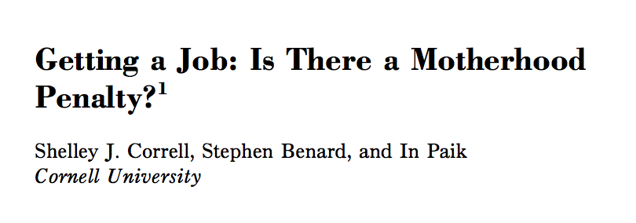
Barriers to rising — bias in resume callbacks
@UBP_STEM // http://www.jstor.org/stable/pdf/10.1086/661653.pdf
http://www.nber.org/papers/w21560 // http://dx.doi.org/10.1080/08959280903120261
http://gender.stanford.edu/sites/default/files/motherhoodpenalty.pdf
Notes:
Once you’ve applied for a job, study after study has found evidence of bias against almost any marginalized group you can think of in terms of who gets called back for an interview. I’ll go through a few papers that make this point.
In this paper, they found bias against openly gay men, even in regions where discrimination against gay people was illegal.
This study found bias against people with disabilities, even when discrimination was illegal, and even when the disability was unrelated to ability to perform the job.
In this study, being a parent hurt job prospects for women. But the opposite was true for men: being a father actually improved job prospects. This finding was from the US, and the same result has been found in China.
And one last example, bias was found against people with Arabic names, both among American and among Dutch reviewers.
Imagine experiencing these biases every time you want to change companies, or even move up within your own org. Imagine how much worse the bias might be if you’re a Arabic lesbian mother in a wheelchair.

Slide 27
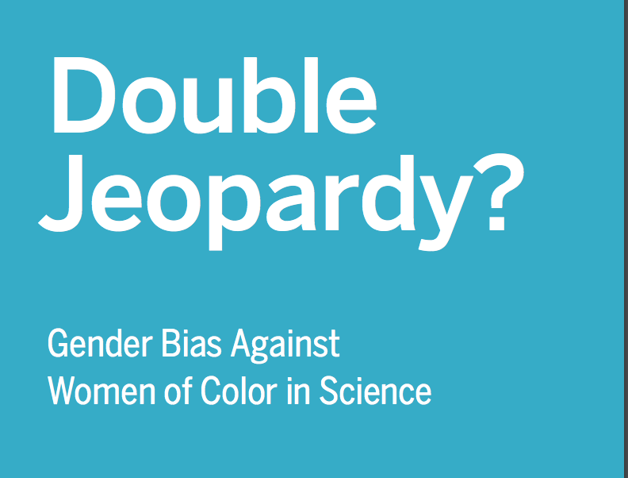
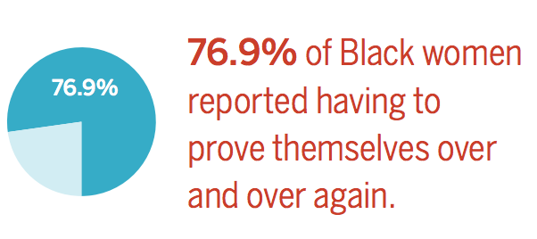
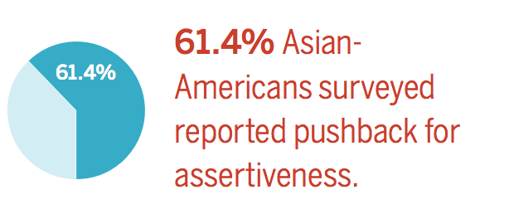
Barriers to rising — prove it again
@UBP_STEM // http://www.uchastings.edu/news/articles/2015/01/double-jeopardy-report.pdf
Notes:
Studies have actually looked specifically at this kind of “intersection”, for instance between gender and race. There’s this great review called Double Jeopardy about the specific issues that women of color experience in science. Women and racial minorities are both less likely to be given the benefit of the doubt, and the problem is only worse if you’re both a woman *and* a racial minority. But when women of color *are* assertive when they demonstrate leadership and competence, the data shows that they get extra pushback for it.

Slide 28
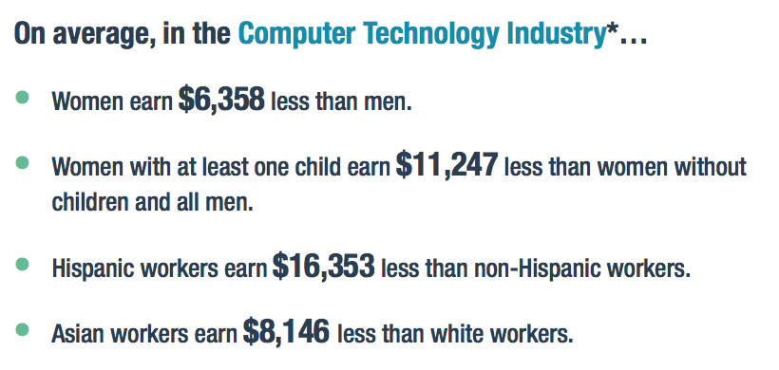
Reasons for leaving — pay gap
@UBP_STEM // https://www.aier.org/sites/default/files/Documents/Research/pdf/IB20140918_0.pdf
Notes:
One reason is financial. There is a pay gap in tech between men and women, between white people and racial or ethnic minorities, and between moms and everyone else. This data is from tech workers who come to the US on H1B visas, which is a great source of transparent salary data.

Slide 29
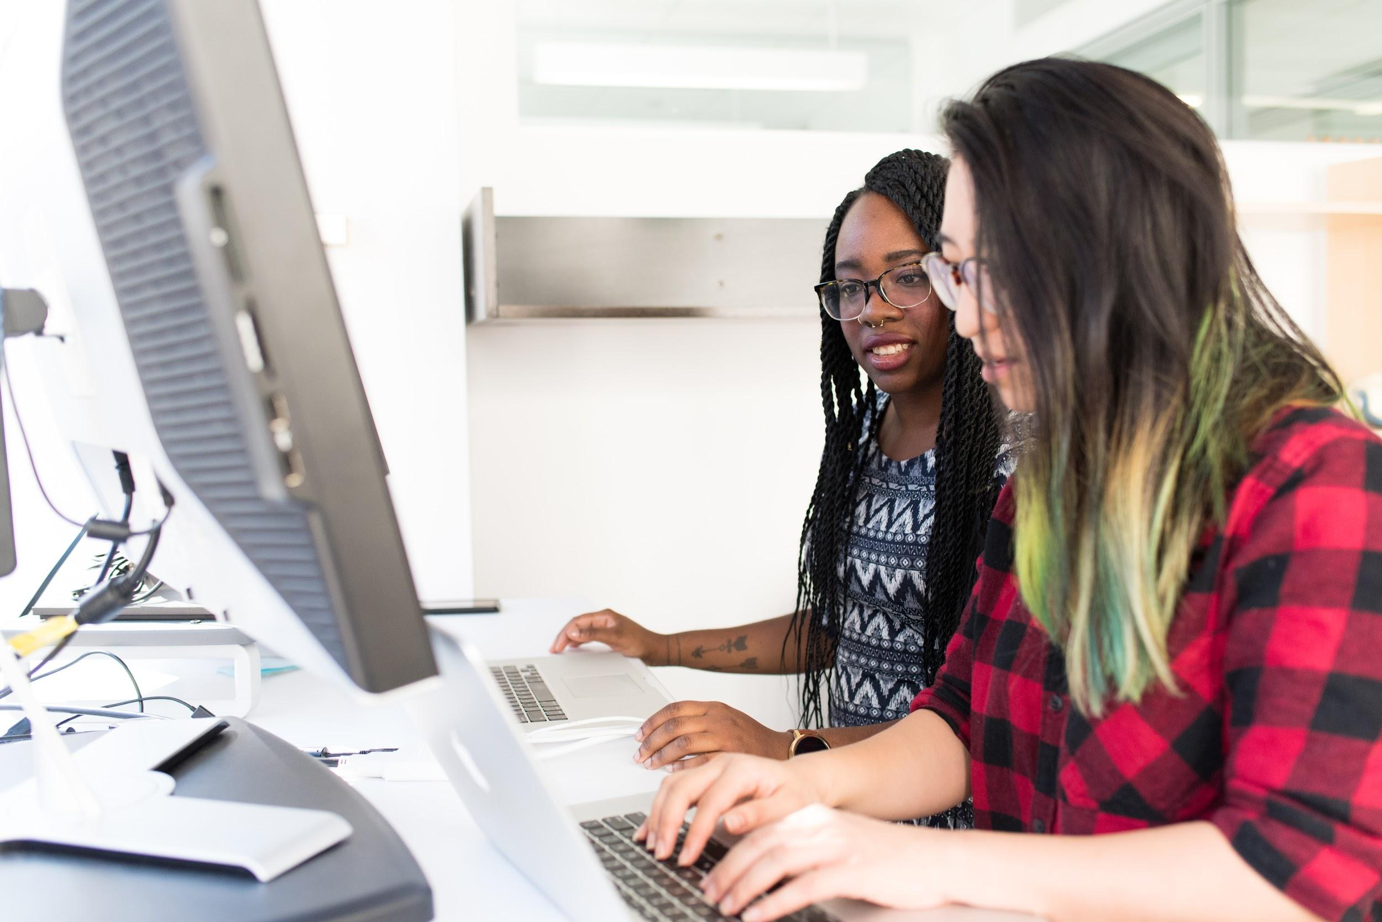
Stereotype replacement
@UBP_STEM // #wocintechchat
Notes:
One strategy is stereotype replacement. The idea here is to consciously recognize that a thought you just had stemmed from a stereotype, instead of leaving that bias buried in your unconscious.
Take a look at this picture - what was your first reaction to it?
Did you assume each of these people are engineers or designers, beginners or experienced, straight or queer, employees or founders, disabled or not, communicating well or poorly. Then when you’ve acknowledged what’s going on in your brain, you can choose to replace any biased aspects of your gut reaction with different, less stereotypical thoughts.

Slide 30
Perspective taking
@UBP_STEM
Notes:
Perspective taking! If you find yourself thinking stereotypic thoughts about a user, imagine how hurt you’d feel if someone assumed the worst about you based off of your name or a physical trait you had no control over.

Slide 31
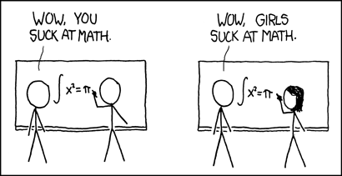
Individuate instead of generalizing
@UBP_STEM // https://xkcd.com/385/
Notes:
Individuating. Instead of lumping a person in with all the members of some group, try to get to know them as a unique person. If you’re just passing them on the street, note their particular style, or glasses, facial features, etc.

Slide 32
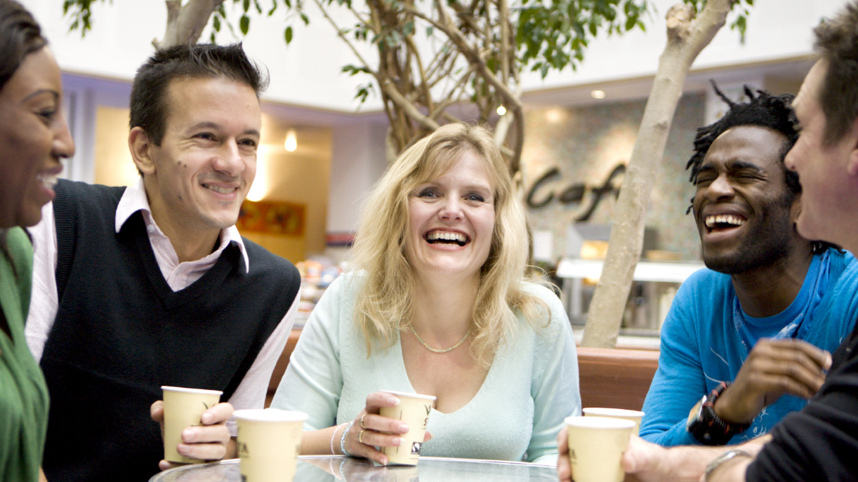
Increase opportunities for contact
@UBP_STEM
Notes:
The last one is pretty fun: increasing opportunities for contact. All these approaches play off each other, too. As you get to know more people from a given group you might be biased against, you can use them as a counter-stereotypic example, and so on.

Slide 33
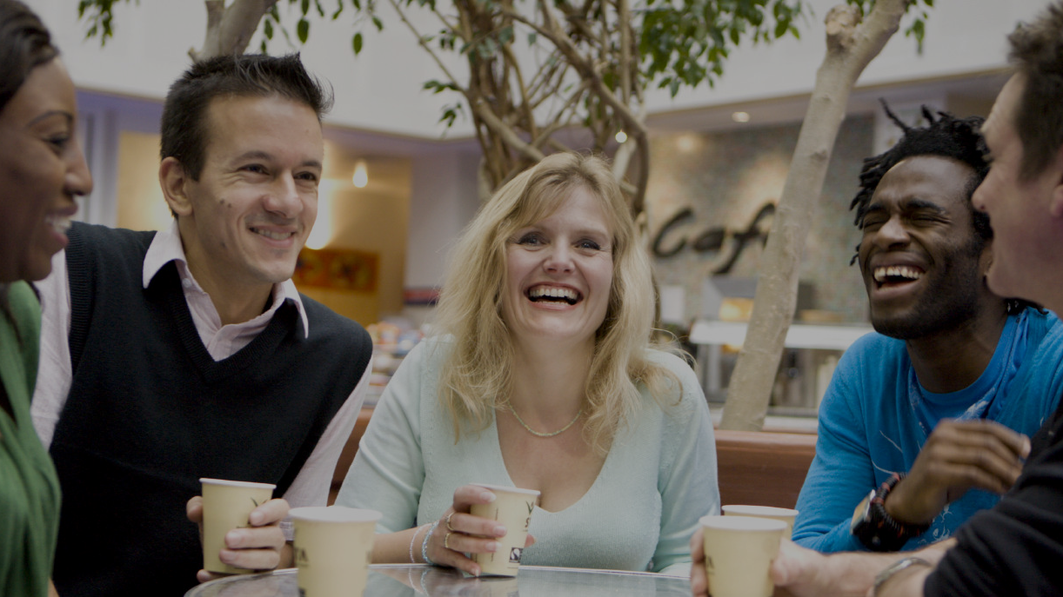
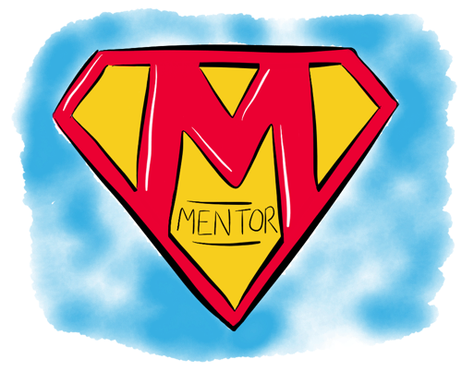
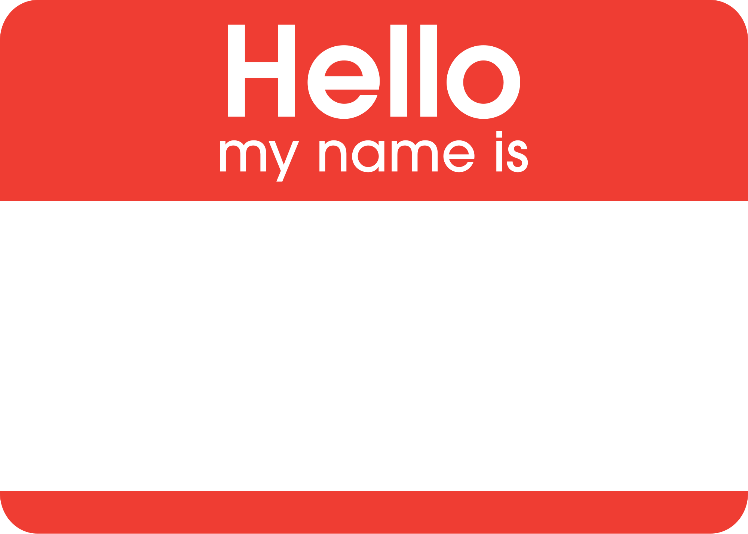
Increase opportunities for contact
@UBP_STEM
Notes:
A few ideas here… you can try a new hobby or coffeeshop, follow folks on twitter, shadow user research interviews, contribute to an open source project with diverse maintainers, and mentor someone new (or find a mentor for yourself!). Whatever feels like a good step to you, you don’t have to be a social butterfly.

