Slide 1
How to Use Social Media to Boost Your Research Career
Cat Adams
Biosciences Area
August 30, 2018
@ScienceIsMetal
Notes:
Thank you so much to Lida for the invite and to everyone for planning this fantastic mini conference.
I’m Cat! I’m a PhD student at Berkeley in Tom Bruns’ lab. Today I’ll be telling you about how to use social media to boost your research career.

Slide 2
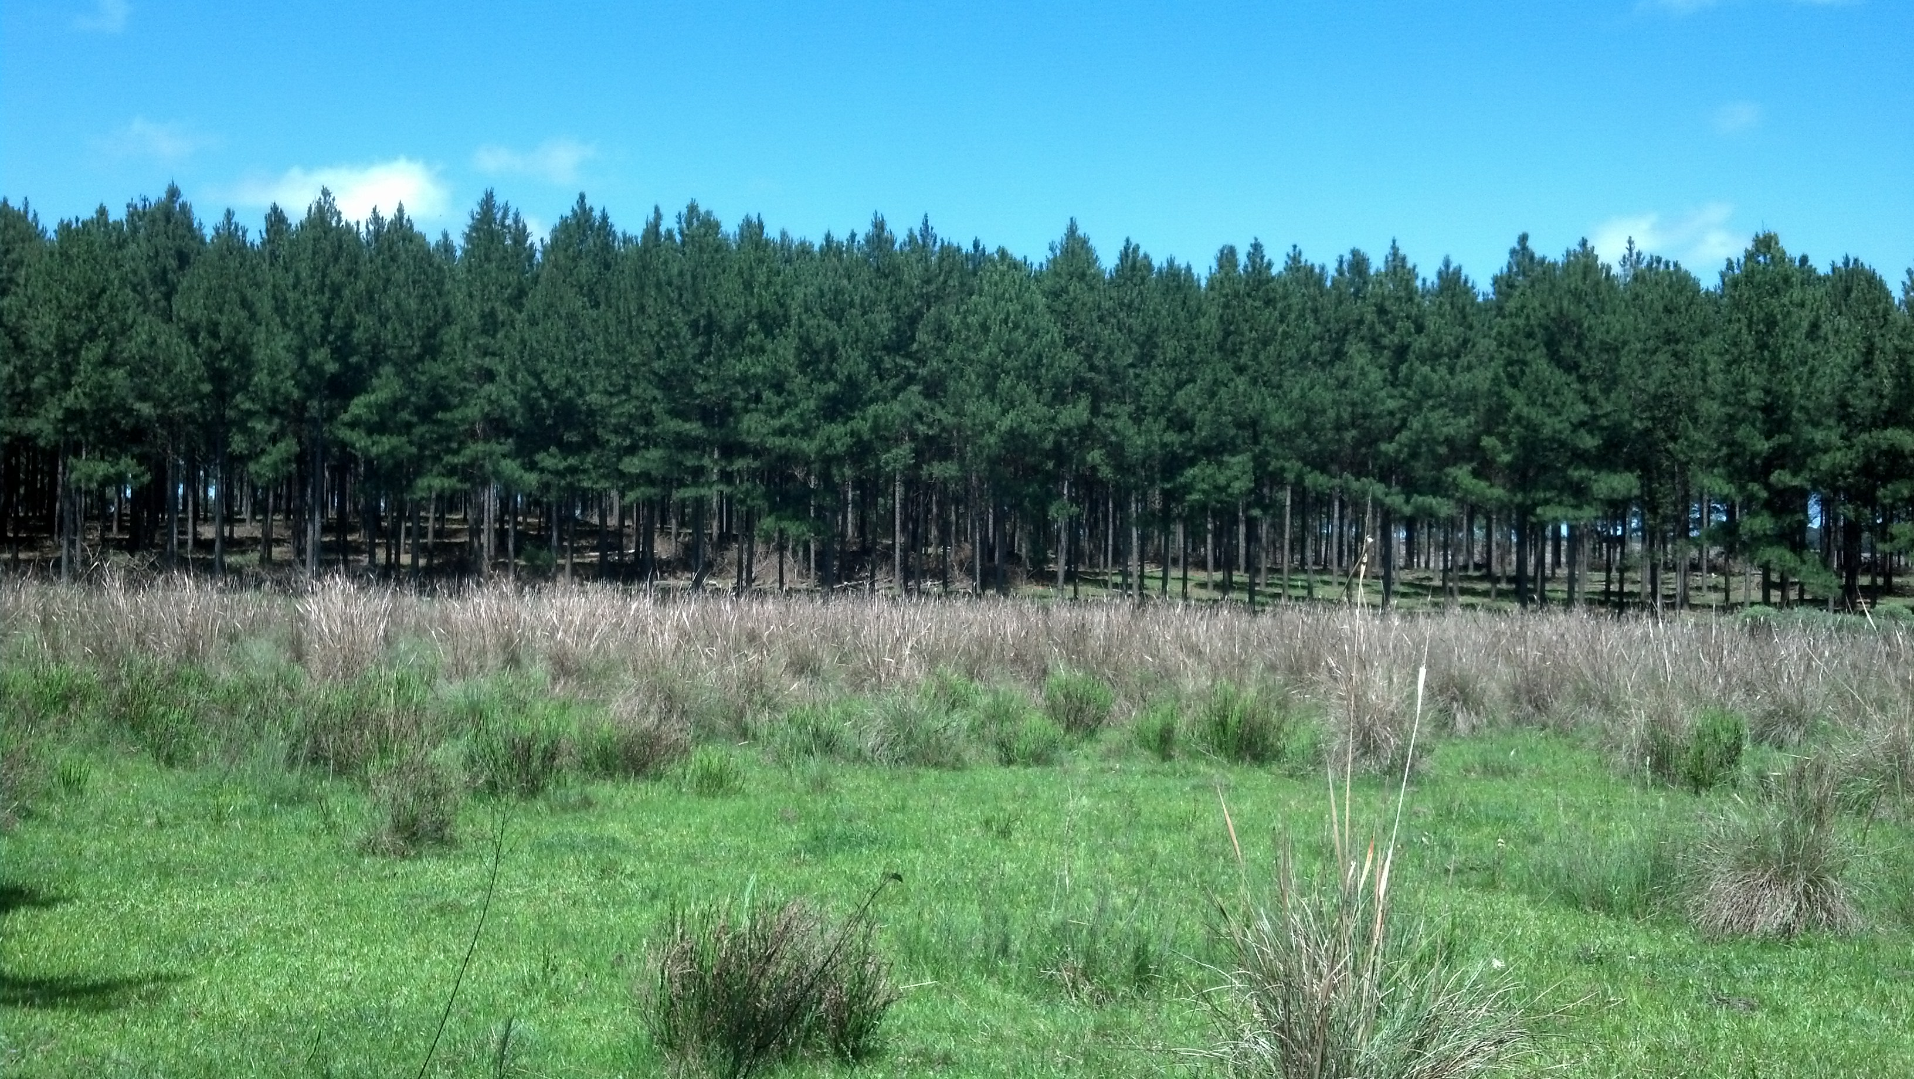
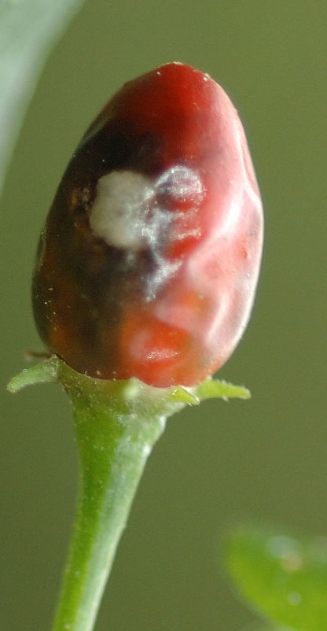
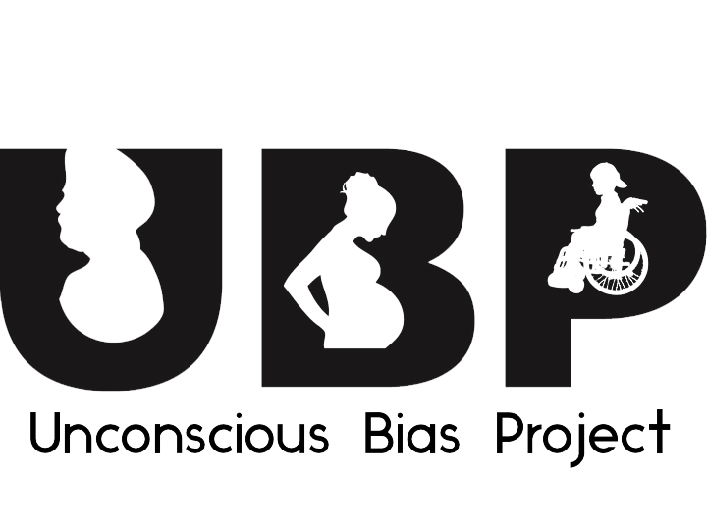
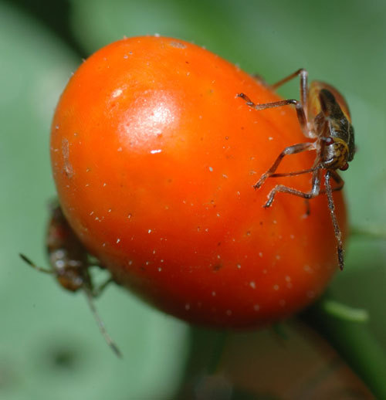
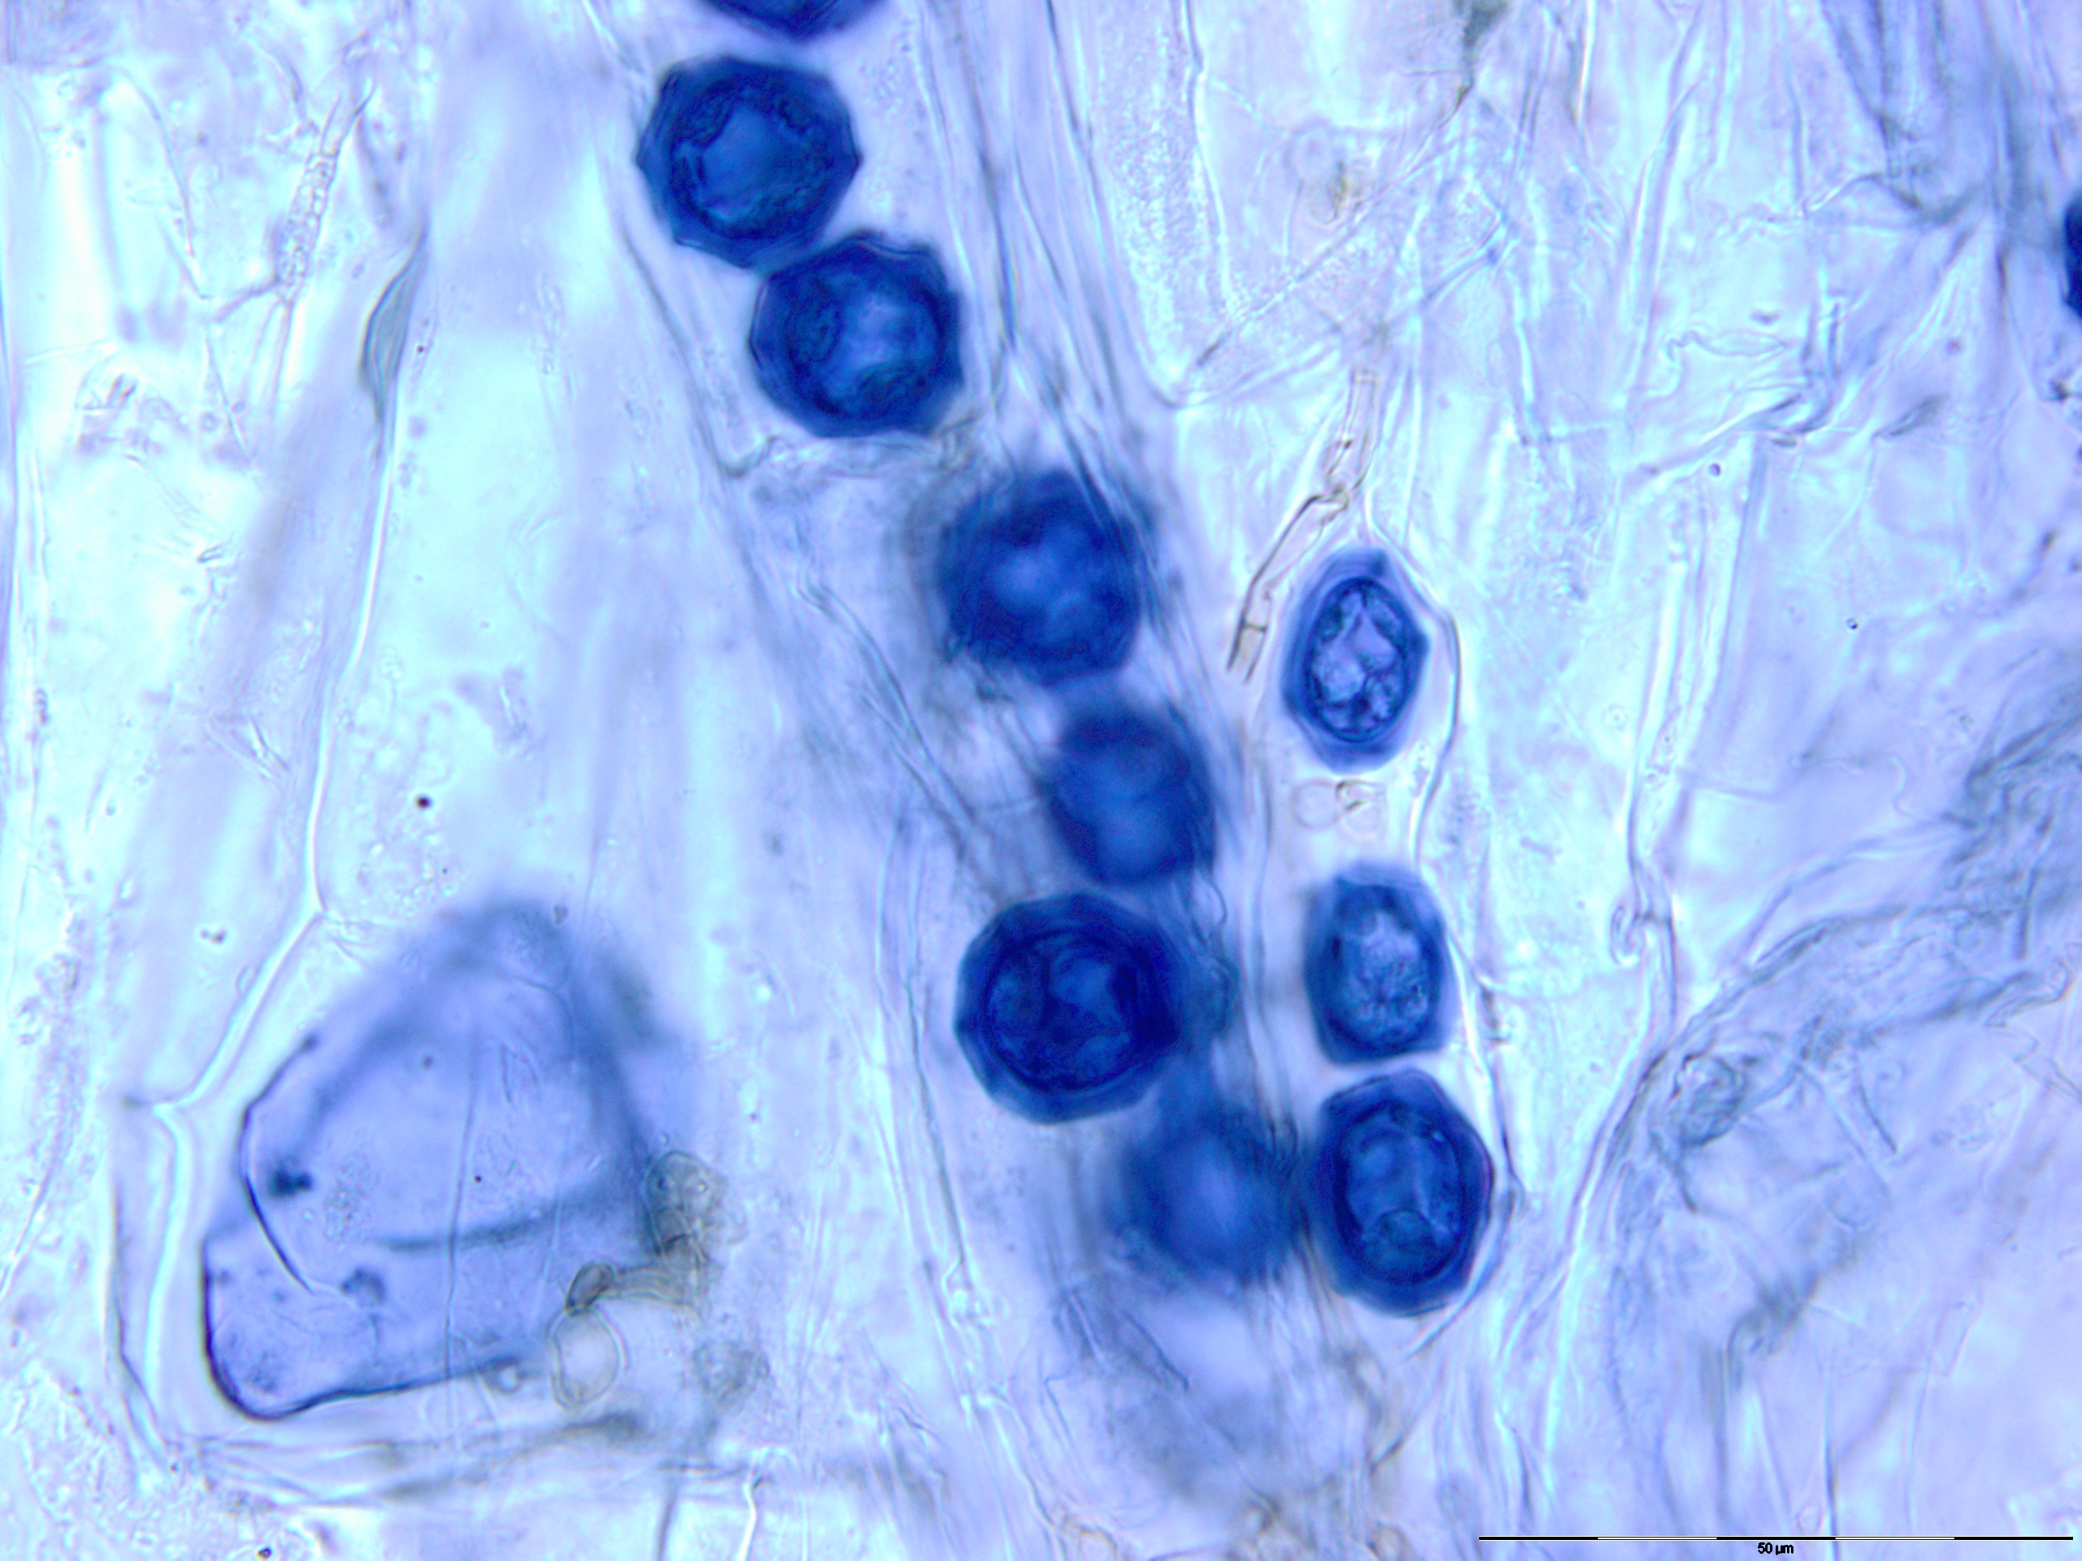
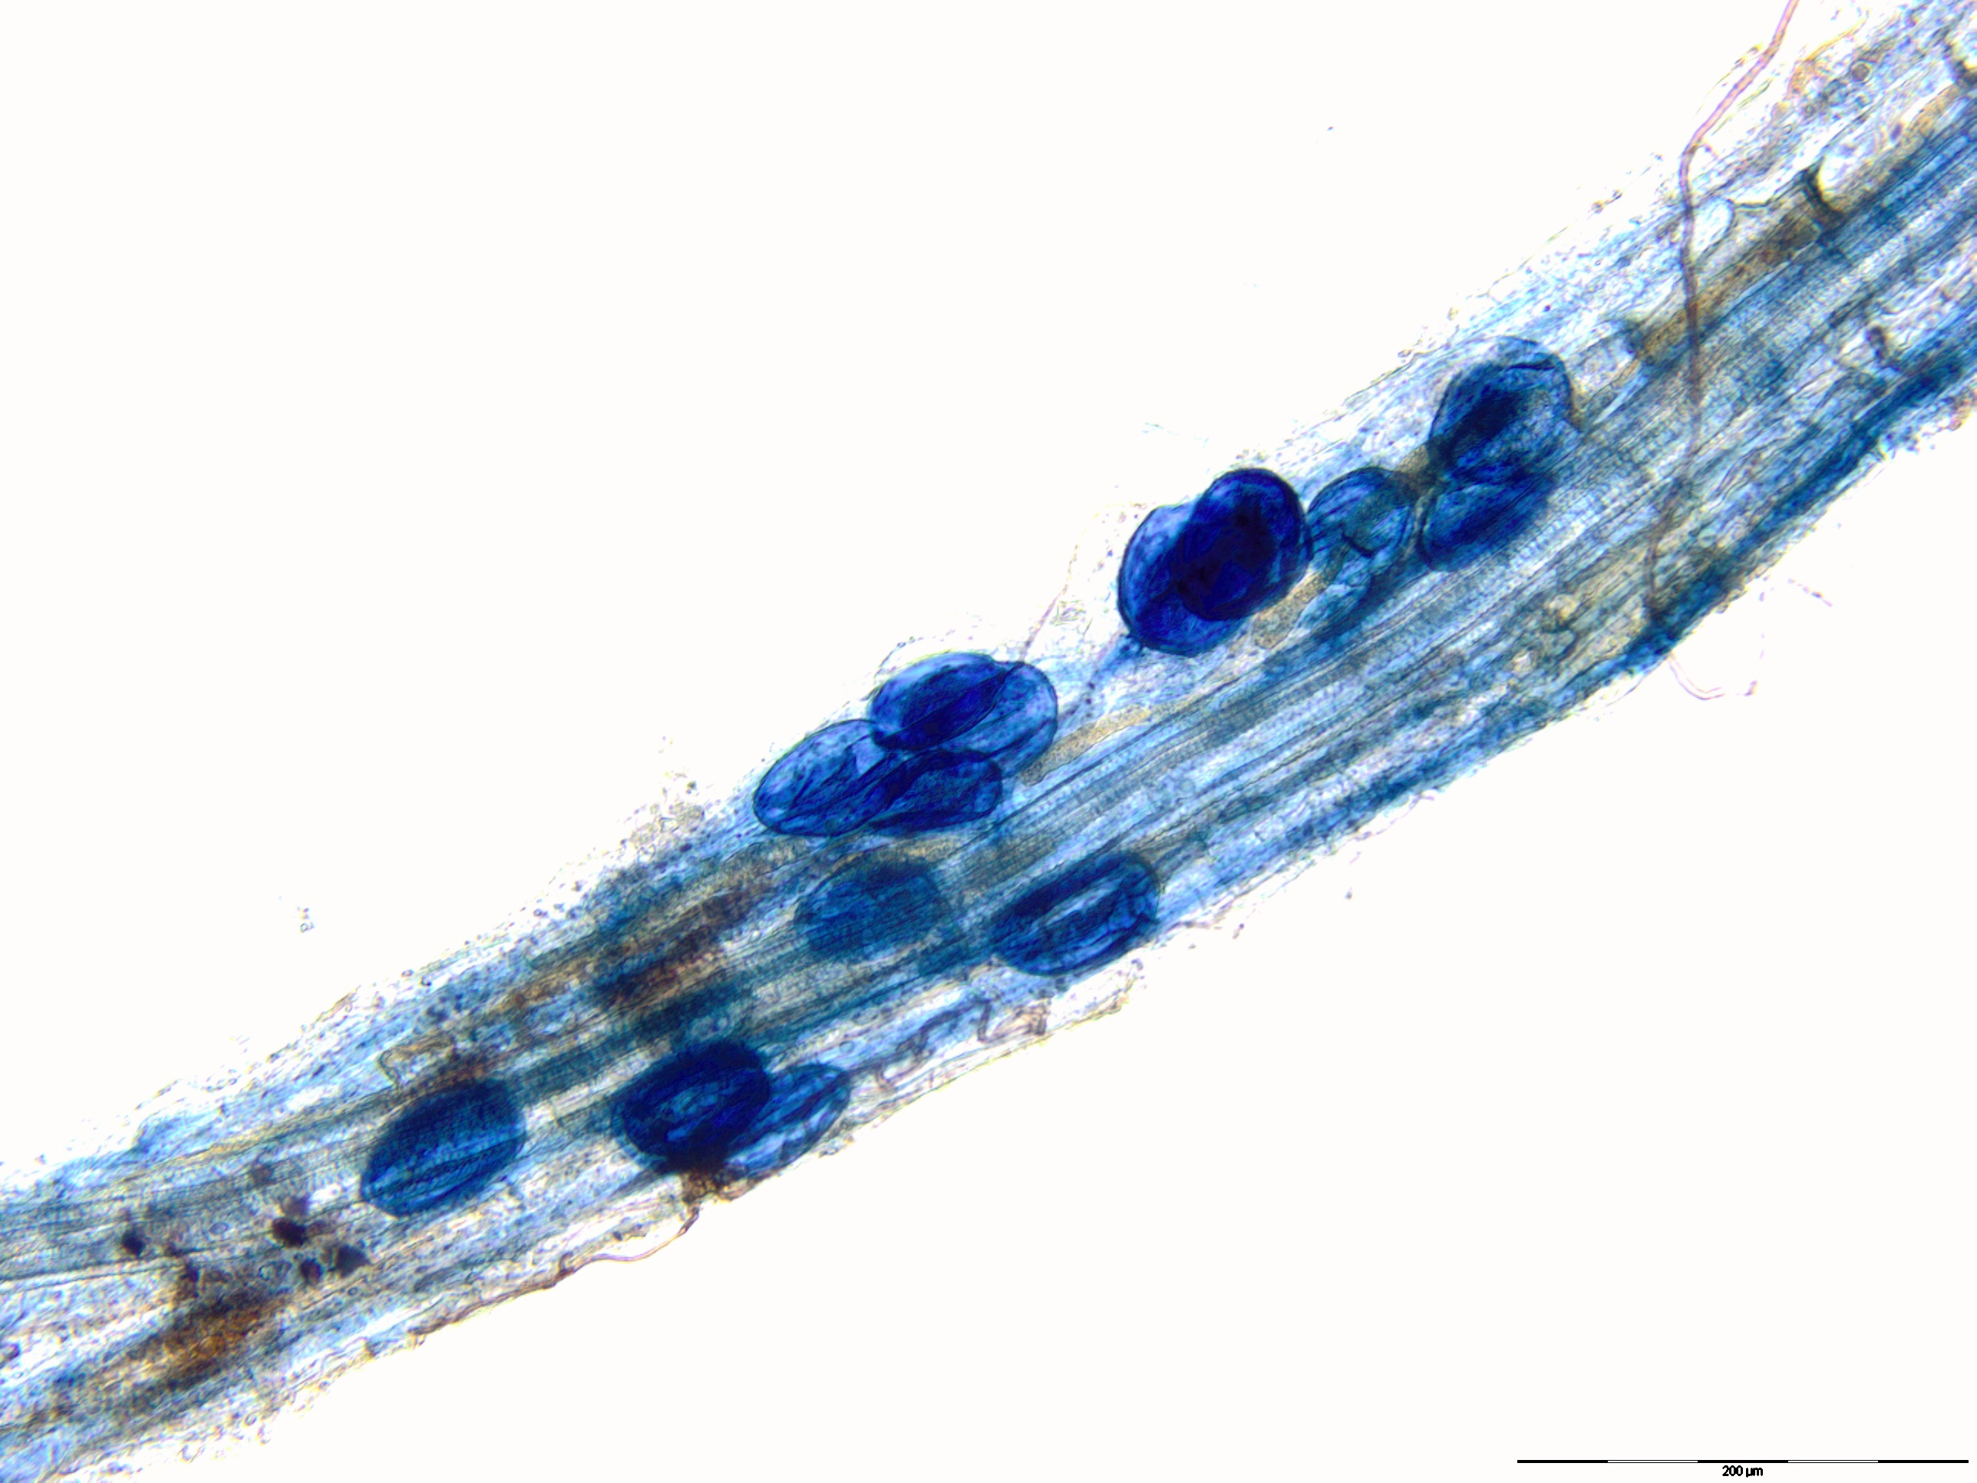
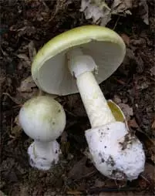
About me…
Notes:
Really fast, who am I? As a scientist I’m interested in how chemistry influences fungal interactions with plants and microbes. Undergrad: chili peppers. Let me know if you want to swap manuscripts! My old advisor really wants a second opinion but I really just want to submit it!
As you can see on my business cards, my PhD is on the chemical ecology of the death cap mushroom, and I’ll be ready to share some cool findings at next year’s conference, so stay tuned.
And as for this talk, I gained a lot of experience writing for general audiences and running social media as the very first Communication Chair of the Mycological Society of America Student Section, so a special shout out to the student section for creating such great opportunities.
I gave the first version of this talk with Lynne Body at a Fungal Genetics conference at Asilomar, thanks Lynne! I spent a good while researching sources for that talk and I’ve since added more materials too. Whenever possible, I give examples from my own academic career to highlight just how useful using social media can be.

Slide 3
“Social media are computer-mediated tools that allow people to create, share or exchange information, ideas, and pictures/videos in virtual communities and networks” (Wikipedia).
Notes:
Let’s start by defining what ‘social media’ means.
With this general definition, most things that you post publically on the the internet can be considered social media, which makes social media incredibly powerful tools for networking, education, and outreach.

Slide 4
Outline
Twitter
Facebook
Blogs
Science Journalism
Slides: www.ScienceIsMetal.com
Also: How to make articles go viral
Notes:
Today I’ll start with an overview of twitter, how to use it well, and how using twitter can further your research career.
Then I’ll talk a bit about Facebook, which I think could be a great avenue for communicating to the public about your research and scientific topics you’re concerned about. I’ll briefly mention blogs, then I’ll transition to talking about online science journalism and give you some writing tips that can also help your academic writing.
This whole presentation is available online at my blog, www.ScienceIsMetal.com
There, you’ll see the slides presented today plus slides with all the sources I pulled statistics and recommended tips from, and then even more advice than I have time to offer here. The slides include all my speaking notes as well, so if you’re visually impaired you can use text to voice and not miss much.

Slide 5
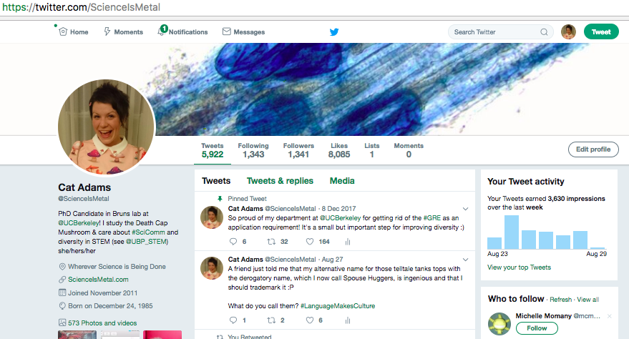
Twitter
Haiku format of social media
Write short posts, or “tweets,” to your followers using ≤ 140 characters
Notes:
Twitter is the haiku of social media. It’s a microblogging site, wherein a tweeter writes a very short post, called a tweet, to their followers, using 140 or fewer characters.
Through a show of hands, how many of you are on twitter? How many of you are “on” Twitter but don’t really do anything with it and hardly ever post? Alright, I’m going to try to change your minds as well as the minds of you that didn’t raise your hands. Twitter can be super useful, but you have to put a little effort into it up front.
For those of you unfamiliar with Twitter, let me just walk you through what the site looks like.
To “get on” Twitter, you have to create a profile. This is my profile, @ScienceIsMetal. The photo shows me in one of my mushroom dresses, and here’s a cover photo from my work in Uruguay. I wrote a short bio, with some of my favorite topics, and a few of my professional affiliations.

Slide 6
TweetDeck
Notes:
If you were to go to my profile and look at my tweets, my posts, this is what you would see.
You’ll also see tweets where people have tagged me by putting the @ symbol in front of my username.
The green symbol here is a retweet, so this number means Malcom’s original tweet was reblogged 7 times. The yellow symbol means it was favorited 5 times.
If I logged into my twitter, this is what I would see, my news feed. It’s just a running stream of chronological tweets from everyone I have followed. If I wanted to organize these tweets by category, like scientists, social justice activists, and cute animals, I could use a program like Tweetdeck to organize the accounts I’m following into Lists.

Slide 7
#Hashtags
Sort and follow trends with #hashtags
#Mushrooms
#FungalFriday
#FungiFashion
Notes:
If I want to look up a certain topic, I can make use of hashtags, denoted by the pound symbol. Hashtags are like keywords for social media.
For example, an amateur mycologist just getting excited about fungi might type “hashtag fungi” in the search window here and see all the posts anyone has ever written that include the hashtag fungi, favoriting the ones they like.
People really do this. One day I received a notification that a lab tech company retweeted some silly tweet I made over a year earlier about how hard it is to load nanodrop samples after too much coffee. Hashtags are an extremely useful tool for following topics you care about, and to see who is writing about them.
On your personal feed page, you can see trending topics on the left side, and I highly recommend jumping in on these conversations, like #CarrotForANight. I honestly don’t even know what pop culture reference this hashtag was originally meant for, but I co-opted it to make a joke about fungi, and a bunch of people saw it, favorited it, and retweeted it, and I picked up a few more followers.
You folks might like hashtags such as...

Slide 8
Academics on Twitter
Conference participants are 10-28% more likely to use hashtags than the average Twitter user
Of academics on twitter, over 80% find it useful for academic work
Approximately 30% of tweets sent by academics contain a hyperlink to a peer-reviewed resource
Academic tweets are 9x more likely to be retweeted than non-academic tweets
Notes:
Academic conferences like this are one of the best reasons to use twitter. Conference participants are 10-28% more likely to use hashtags than the average Twitter user.
You can make yourself seen by tweeting at the conference and using the conference hashtag, or if you can’t attend, you can still follow the hashtag to know which talks got a lot of attention.
Partially because there are so many academics on twitter, over 80% of academics using twitter find it useful specifically for academic work.
This is very likely due to the fact that almost a third of tweets sent by academics contain a hyperlink to a peer-reviewed resource. Twitter is a great way to see which papers the people in your subfield are excited about.
Academics are good at supporting each other. Academic tweets are 9X more likely to be retweeted than non-academic tweets.
Another thing to note is that the vast majority of twitter users are passive users: they follow a bunch of people but don’t really create a lot of original content. So if you’re on twitter and you put your thoughts and ideas out there, a lot of people might see them. Using hashtags is a great way to get your tweets seen, too.

Slide 9
Increase citation rates
Notes:
And, if you’re still not convinced that Twitter is useful, at least in the field of ecology, we now have peer-reviewed evidence that using Twitter to promote your papers can increase citation rates. This paper showed the same overall trend with citations, and that scientists who use Twitter communicate their research to more citizens, too.
Twitter connoisseurs like Mike Eisen use the pinned tweet feature to help advertise recent pubs, which can greatly improve visibility and wrack up those tasty tasty citations.

Slide 10
Career Opportunities
Notes:
Just being on Twitter and tweeting can also bring about some pretty awesome collaborations.
A few summers ago I was at ICOM8, and I was being quite active on Twitter. I mentioned some work a collaborator is doing, and none other than the illustrious professor Francis Martin, who was following the conference from home, expressed sincere interest in our project. Francis basically offered to help us with a bunch of our genome sequencing. It was pretty awesome, and then we moved over to email to follow up on the collaboration. He would not have known about the project if it weren’t for Twitter.
Here’s a pixelated example of a recent Twitter bonus I experienced. A grad student I only know through twitter messaged me to ask if I wanted to be on his podcast to talk about a recent publication. I agreed, and now I have some extra free publicity, because I tweeted about our paper when it came out.

Slide 11
Other Twitter Uses
Building your professional network
Learn about research, workshops, jobs, calls for proposals
Find resources
papers (#ICanHazPDF), protocols, code, etc
Follow conversations
ex: #TimHunt, #OverlyHonestMethods
Top-notch customer service
Notes:
Twitter can be a great way to extend your professional network. For example, I have never met U of Arizona professor David Baltrus in real life, but we follow each other on Twitter and he’s helped answer a number of questions I’ve posted.
It’s highly recommend that you follow the big journals and names in your field, to learn about research, workshops, jobs, calls for grant proposals, etc.
You can easily track down hard to find papers, protocols, or ask the so-called Twittersphere for help with a coding problem or the like.
You can follow conversations in real time. These might be serious conversations like the one about Tim Hunt, to fun light-hearted conversations like OverlyHonestMethods. OverlyHonestMethods was HILARIOUS, and you should google it later if you’re unfamiliar.
Twitter is also a great venue for boosting replies to papers. This is a snarky image my advisor Tom Bruns and professor John Taylor made in response to a paper that tried to claim arbusuclar mycorrhizae don’t have endemism. The science of the paper was sound, but their titular claim was a bit ridiculous, because the barcoding region they used likely holds order-levels of genetic variation, not species. Their conclusion was like saying that humans and wombats are conspecific.
Anyways, Twitter can also be a great way to ask questions or get immediate customer service from a company like Dropbox. Companies respond very quickly over Twitter, as a general rule, because it’s a public forum.

Slide 12
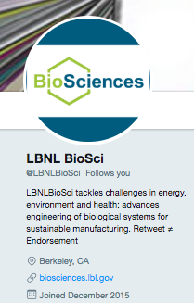
Get started
Use your real name
Follow a few hundred people
Mark favorites, retweet others
Notes:
Ok, so now you’re super stoked about twitter, right, and you want to make an account.
You could make many different types of twitter profiles.
You could take the snarky social commentary approach like NIH Bear or SarcasticRover. Or be witty but anonymous like Prof-like Substance or Drug Monkey.
But to get the most actual career-use out of your account, folks recommend you be fully transparent like Michael Eisen or Jason Stajich here.
Put up a picture, and fill out the text about you so that people know what you do and that you’re not a bot.
Follow a few hundred people so you can start getting a sense of what people write about and who has a lot of of followers. If you want ideas for who to follow, check out who LBNL Biosciences is following. That will give you a solid starting place, and then twitter will give you suggestions of other similar accounts to follow.
Then start engaging! Retweet useful-seeming tweets like job openings, mark funny tweets as favorites, etc.

Slide 13
Bio disclaimers
http://socialmedia.lbl.gov/guidelines-info/
Notes:
Speaking of bios, ya’ll should remember that your Twitter bio can be a great place to clarify to the public what your role is, and who you work for. A disclaimer like “Views are my own,” helps with that, but know that disclaimers don’t have any legal substance. Disclaimer or not, your social media activities definitely reflect on your employer, so try to keep it civil. Berkeley lab staff have some social media guidelines at this website and I encourage you to take a peek if you haven’t already.

Slide 14
Twitter Tips
Keep tweets brief to allow replies
Follow and use hashtags, learn Twitter grammar
Example: .@ScienceIsMetal appears to all my followers
Participate regularly, spread out posts (ex: Buffer)
Engage with others, say ‘thanks’
When posting news articles, include commentary
Don’t just make statements: ask questions!
Keep it positive
Notes:
To get the most use out of Twitter, like increasing your citation rates, you have to cultivate a following BEFORE your next paper comes out.
One of the easiest ways to have a lot of followers is to be a famous professor, but if you’re not famous you’ll have to work a bit for it. Here are some concrete tips for how to use twitter well.
Though you have 140 characters, it’s generally recommended that you keep posts shorts so there is more room for replies that quote your original tweet.
Jump on hashtags!
Learn grammar.
By ‘participate regularly’ most people recommend tweeting at least daily. One of the most surefire way to make people unfollow you is to write too many posts in a row. Unless you are Cell or Nature, don’t do this.
If you want to write all your posts once in the morning but have them appear throughout the day, you can use a program like Buffer.
Engage with others. If I’ve noticed someone favorited several of my tweets, I might follow them back even if they only have a handful of followers.
People are split on this, but many recommend that when you link to a news article, add a bit of your own personal commentary to it. You’re not a news aggregator; people followed you because you’re a person, so give your tweets some personality.
Ask questions! Put ideas out into the world.
This should go without saying, but keep it positive. Being negative too much of the time will lose you followers, and I have seen that myself when I’m really stressed and not curating my posts well. I suggest avoiding twitter during those times. Lots of people will also unfollow you for writing about sexism and/or racism too, even if you’re anti sexism and racism, so just know that that’s a risk for tweeting about controversial topics. I think it's still worth doing, but just know it's a hard selection.

Slide 15
Brevity
1) Make characters subjects and their actions verbs
2) Place subjects and verbs close together
3) Favor the active voice
4) Use short words instead of long ones
www.tinyurl.com
5) Use present tense or simple future
6) Drop prepositions and conjunctions
7) Use pictures for longer messages
“Writing science in plain English” by Anne E. Greene
Notes:
Twitter is great practice for trimming the fat off your writing. So, I added this slide for when I gave this talk to a science communication class. The tips come mostly from this excellent book, “Writing Science in plain English,” by Anne Greene. There are some very simple grammar rules you can adopt to keep your posts punchy.
Not “The lab is getting a new postdoc.” but rather “A new postdoc is joining the lab.”
Not “Jay, after much deliberation and thought with respect to JBEI’s long term goals and priorities, funded the postdoc” but rather “After much deliberation and thought with respect to JBEI’s long term goals and priorities, Jay funded the postdoc.”
not “the postdoc was funded by Jay,” but “Jay funded the post doc.”
Fast vs Expedient
Not “Jay will be funding the post doc soon” but “Jay will fund the postdoc soon”
Prepositions like In, around, about. Conjunctions like “but, however”
Pictures! You can say a lot with a picture. Here’s one I tweeted about identifying the shaggy mane mushroom. I used #mushrooms and got 5 retweets and 6 favorites, which isn’t half bad.

Slide 16
Twitter Abbreviations: Technical
CX: correction
CT: cuttweet (= partial retweet)
DM: direct message
HT: hat tip
MT: modified tweet
PRT: please retweet
Notes:
Speaking of brevity, I looked over all the Twitter abbreviations from www.SocialMediaToday.com and selected the fraction that I have personally seen used often and consistently, so put them here for your reference.

Slide 17
Twitter Abbreviations: Conversational
AB/ABT: about
BGD: background
BTW: by the way
F2F/FTF: face to face
FF: follow Friday
FOTD: find of the day
FWIF: for what it’s worth
HOTD: headline of the day
ICYMI: in case you missed it
IDK: I don’t know
IIRC: if I remember correctly
IMHO: in my humble opinion
IRL: in real life
OH: overheard
NTS: note to self
PLMK: please let me know
QOTD: quote of the day
TFTF: thanks for the follow
W or W/: with
Notes:
And here are a bunch of conversational abbreviations that you can read up on later. I wanted to highlight two really useful ones, starting with Follow Friday. This is a great hashtag for trying to boost the popularity of your friends, on Fridays. There are purely academic versions of this too.
Someone did this for me a while ago, for example. The tweet reads “Following @ScienceIsMetal for, well, it’s self-evident isn’t it. #ScholarSunday.
Another classic hashtag, ICYMI, is often used when a person repeats the same tweet to increase its visibility. It’s sort of a polite way of saying “I know I already tweeted this but I really want people to see it. Forgive me.” It’s good for things like recent paper publications that you might want to tweet a few times.

Slide 18
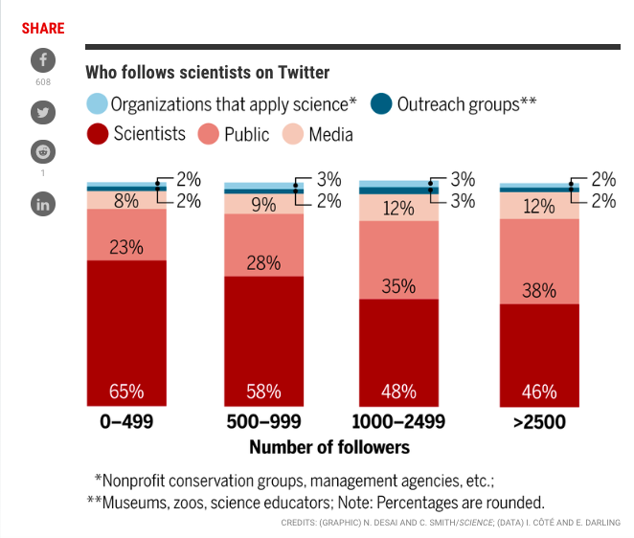
Twitter Analytics
Notes:
If you like crunching numbers, and who doesn’t really, you can log into your twitter account, go to analytics.twitter.com and turn on Analytics. Twitter lets you quantify how many people saw your tweets, clicked links, etc.
For example, Lida sent me an article recently showing that after you gain 1000 followers, there is a sort of tipping point where scientists are followed by a more diverse set of Tweeps: more members of the public and media etc, and that might be fun to try to track with Twitter analytics.
Unless there are any questions about Twitter, I’ll move onto Facebook.

Slide 19
Facebook
World’s largest social media platform
Common interest “groups” and “pages”
Notes:
Facebook is the single largest social media platform in the world. 48% of young Americans check Facebook first thing in the morning.
Moreso than Twitter, Facebook can be a really great way to build a community around a common interest, like biofuels, or microbial-produced medicine, or whatever you’re passionate about.
As I mentioned, I was in charge of popularizing this Facebook page for the MSA Student Section. Though we had originally intended the group to be mostly for students, all the news articles I posted quickly brought us over 1000 followers.
We’ve had mycological clubs share their award applications with us, and even had mycologists ask the group where people have seen certain mushroom species, to aid with collecting endeavors.

Slide 20
Facebook
World’s largest social media platform
Common interest “groups” and “pages”
Notes:
You can use Facebook to actually conduct science, too. Here’s an example of a PhD student that used crowdsourcing to identify fish for a project. It’s kind of a cute story:
(from Phys.org)
“In order to get the fish out of the country, the research team need needed an accurate count of each species and provide a detailed report to the Guyanese government. Since the team had to return to North America as soon as possible, they had just a few days to identify thousands of fish specimens.”
So they loaded all the photos on Facebook. “And in less than 24 hours, their network of friends—many of whom hold PhDs in ichthyology and are "diehard fish-heads"—had identified almost every specimen. With 5,000 identifications in hand, the team was able to deliver their results to the government and return home on schedule.”

Slide 21
Awesome potential
Notes:
Facebook can also be used to get the more general public excited about science. The “I Effing Love Science” group is a paragon example of that.
They have almost 22 million followers and are really doing a lot to communicate science to the public. So HT, hat tip, to them, for spreading the scientific word.

Slide 22
Facebook Group tips
Flesh out group profile: leave no field blank!
Assign admins, keep notifications on
Know the algorithms:
Time and day of week matter
Post mornings & after lunch
Posts are seen more on weekends
Link to outside websites
Use many high-quality images
Wit and humor go a long way
Spread posts out throughout the day
Notes:
Much moreso than Twitter, to make a page popular on Facebook you have to understand Facebook’s algorithms.
When it comes to posts, Facebook is set up so so that the rich get richer. The “good stuff,” the posts that people like and comment on the most, will be seen by more, and the “boring stuff” will appear in fewer peoples’ feeds.
To increase the odds that your posts are seen, follow these tips.

Slide 23
Blogs
Idea: “CRISPY Bites”
Notes:
I reckon there are some of you in the audience that might be interested in writing longer content, to be posted in a public forum.
It turns out there are about as many different types of blog formats as there are types of social media platforms, and you just need to figure out what kind of blog works for you.
You could just create your own blog with Wordpress like I did, which is very straightforward and doesn’t require any programming knowledge. When I won the NSF Graduate Research Fellowship, one of the reviewers explicitly mentioned my blog and how it was a great idea that can reach a lot of people. Blogs like this, even though I don’t post often, really do pop out on a resume.
Or, you can write for Labs and University department blogs, like the Cornell Mushroom Blog.
Sometimes, a few people get together to make a blog with a unifying theme, like Small Things Considered, or Dynamic Ecology. If you and 3 people team up and each write once a month, you can have a weekly blog post, which is great!
There are some great blogs about paper synopses, the first of which I’d heard of was Astro bites. Groups of volunteer writers create synopses of papers shortly after the papers are published, translating the text to a level a naïve undergrad could understand. My old labmate Holly saw how useful astrobites was for astronomy and promptly made Evo bites to write about papers in evolution.
Folks working in genetic engineering could start a blog about CRISPR papers, blog name suggestion CRISPY Bites, to help dampen some of the fear about genetic modification and spin GMO research in a positive way.
Lastly, there are blogs like Sci Logs, run by scientific journals like Science, with posts written by real scientists such as Malcom Campbell here, for an audience of researchers and science enthusiasts.
But what I often hear from folks is that they don’t feel like they are good enough writers yet to blog, for the public or even for an academic audience.

Slide 24
General Writing Tips
1) Take writing classes
Cal Journalism school!
Notes:
If you want to develop your popular writing skills, here are three things I did that helped set me up for instant success when I tried freelancing.
1) Take classes! One of the reasons I had such a headstart on this topic is because the UW, where I did my undergrad, had a great 3-quarter course series on science journalism, taught by a badass lady named Deborah Illman who had a PhD in chemistry and wrote for several different science journals. I highly recommend this kind of formal training.

Slide 25
General Writing Tips
2) Start small, get feedback
University publications
Notes:
2) Start small. Because of those classes I mentioned, I was able to write for the UW magazine, Northwest Science and Technology Magazine, and then a few more articles for Harvard once I started my Master’s. Schools often have many opportunities like that, usually run by people that will give you useful feedback on your writing. It’s easier to improve your writing with feedback, so consider writing for something like the Berkeley Science Review, to learn some tricks and beef up your writing portfolio.

Slide 26
General Writing Tips
3) Attend SciComm conferences
ComSciCon
Notes:
3) Once I’d done a bit of 1 and 2, I started networking. Science communication conferences for scientists are becoming more popular, and there are some great options now! I went to a great one in Boston run by Harvard grad students, and it’s still going! There are even regional conferences now, so do check them out at ComSciCon.com There were some pretty successful science writers at the workshop to share their experiences and dole out advice. I even got Joe Haldeman to sign my copy of the Forever War ☺ You can make some very useful connections at conferences like this.

Slide 27
Science Journalism
Notes:
If you’re down with a blog, you might as well write for higher tier online magazines that can reach millions of readers.
I myself am evidence that you can do this successfully, even when I was a lowly first year Master’s student with 0 science publications.
As scientists we are also in a great position to know about interesting stories before conventional journalists. I was able to do this with an article I wrote for Slate about the death cap mushroom and a new treatment for amatoxin poisoning, which is still in clinical trial but is very, very promising. I met a journalist that frequently writes for Slate at that ComSciCon conference, and I ran the story idea by him. He said the idea wasn’t half bad, and that I should write a pitch to the Science editor at Slate. So I did, and I was terrified as I sent her the email because I felt like I had nooo idea what I was doing. But Laura gave me some really great feedback and helped edit the piece until it was pretty good. It was shared 3.5 thousand times. But we got a bunch of comments, and the article was featured in a bunch of other news sources, like Popular Science, Discovery, and more.

Slide 28
Science Journalism
Notes:
And once you do start and you have even a modicum of success, success tends to snowball. My first semester at Cal I applied for this new student writing gig with BBC Earth, and I got it! I got to write three different articles for them, though the first one about fungi was my favorite.
The editor changed the headline to this rather clickbaity one, but he was probably right to do so. The story was great!
It was even the most popular article on the BBC Earth website for a while, here under one of the alternative headlines, and was seen by more than 60,000 people just within the first two weeks. The average academic journal article is read, in its entirety, by about 10 scientists. My 60,000 isn’t even counting the other websites that copied all my text and presented it like their own original story. When it comes to sheer numbers, the potential reach you have with a popular magazine like this is soo much larger than a university publication. I am happy to help anyone that’s interested in this route and share all my contacts, too.

Slide 29
Science Journalism Tips
Research the news source
Know their format
Know their story types
Know their pitch
Research your story before you pitch it
Emanate confidence
Expect to write for free at first
However: Popular Science pays $150/article
Listen to your editor
example edits from Slate editor on my blog!
Keep practicing
Notes:
Really briefly, here are some science journalism tips.
First: research who you want to write for. Research what the editor wants, and then give it to them!
Research the story: has another news source covered that topic recently? If the answer is yes, what new angle or nugget of info will your article provide?
There’s actually a lot of scientific evidence for the “fake it til you make it” approach, and I personally highly recommend it.
We already have jobs, which gives us another advantage over traditional journalists, because you probably won’t get paid at first. But do know that you can make a little extra money, too.
Writing for the general public is substantially different than writing a scientific paper, so listen to your editor. They know what sells, and they’re used to this kind of writing. If you go to my blog, Science Is Metal, you’ll see how much the editor at Slate was able to cut from my first draft. It was amazing.
Keep practicing! If you can get formal training, do so.

Slide 30
Science is Writing
Notes:
You know how traveling in other countries gives valuable perspective on your home country? In the same way, I think writing an article or two for popular science gives you perspective that can drastically improve your academic writing and editing skills.
A recent study found that changing up your routine to learn motor skills helps folks learn those skills faster. I will not be surprised if this held true for other tasks like writing. I’ll give you one last example from my own career.

Slide 31
Writing science
Notes:
If you’re self conscious about your skill level and want to write for fellow scientists, I highly recommend this book by Joshua Schimel called “Writing Science: How to write papers that get cited and proposals that get funded.” The book is $30 on Amazon and worth every penny.
I read this book for a class at Harvard about writing scientific papers, and it really is amazing. Josh gives examples from his own work with soil biogeochemistry, and he covers both larger topics like structure and tone, and the nuances of sentence structure and word choice. I think even established professors can learn something from this book!

Slide 32
Writing for science money
Notes:
While I was completing my Master’s at Harvard, this awesome fellow Fa Yuan Wang was a visiting scientist from China. He specializes in arbuscular mycorrhizae, and helped me process some samples from a side project in Uruguay that I’m still hoarding data for. In exchange, I helped him edit several papers to be published in English journals. We both felt like we were getting the better end of the deal, and he was so grateful with how fast and well I was able to re-write his papers that he invited me to be a co-PI on a grant he was submitting to the National Natural Science Foundation of China.
Sure enough, the grant was funded in 2015. As a 1st year PhD student, I became a co-PI on a 6 figure grant to study how arbucsular mycorrhizae can help plants cope with metal-based nanoparticle pollution. We’ve published 3 papers on this topic now, and we recently submitted another grant application to study how AMF can aid phytoaccumulation of nanoparticles.
Native English speakers are really lucky that we just happened to grow up speaking the language that most science is published in. It feels good to help level the playing field a bit.

Slide 33
Free trip to China!
Notes:
It’s also just great because I also got a free trip to China last year.
I got to see gorgeous natural sites, and do silly touristy stuff like dressing up in the emperor’s wife’s clothes.

Slide 34
Odds and Ends
1) Reddit AMA (Ask Me Anything)
Boost your paper/invention/crowdsource campaign
2) Tumblr, Instagram, Pinterest
Like Twitter, but more pictures
3) Podcasts
Practice speaking, crafting stories
4) Wikipedia
Class assignments, conference station
5) Guest lectures
Amateur clubs, citizen scientists
6) Twitch.tv?!
Stream your lab work/field work/programming!
Notes:
In this talk, I try to cover a few topics in depth, but do know there are lots of other opportunities to hone your communication skills and leverage social media for your career. Really briefly, here are five more other outreach ideas you can consider.
The website Reddit has frequent events called AMAs for “Ask me Anything.” An expert in a topic gives some sort of proof that they are who they say they are, usually a photo, and then reddit users ask the expert questions, and the expert answers in real time. This can be a great way to boost a paper or crowdsourcing campaign.
If you like taking photos, tumblr or instagram might be more your style. There are programs you can use to cross-post to multiple social media platforms simultaneously, to save you time.
Podcasts! These are becoming more and more popular, and can be a great way to practice speaking and crafting stories.
4) Wikipedia is becoming popular as a teaching tool not for reference, but for content generation. We can assign students the task of creating Wikipedia pages for under-studied topics. One day we’ll make a Wikipedia station at the annual MSA conference to get more mycologist bios on Wikipedia, too.
5) This 5th one isn’t a form of social media itself, but using social media can help you land speaking gigs, like this one I’m giving right now. This is great for my Broader Impacts, and it’s good speaking practice too.
Lastly, I recently became enamored with a website called Twitch, which is predominately a website people use to stream video games to a live audience. But they recently branched out to stream all sorts of different things like cooking and art, and I think we could stream lab work. I have to do a few hundred toxin extractions and it gets pretty monotonous, so why not explain what I'm doing out loud to anyone watching? It'd be great practice for speaking at a level general audiences can understand, too. And it’s interactive so you can get feedback on whether or not you’re explaining something well.

Slide 35
Summary
Social media can help our careers
Don’t delay!
Follow some tips:
engage, especially at conferences
be nice (unless you’re famous)
use hashtags
Practice makes perfect
Listen to advice from experts
Notes:
I hope I’ve convinced at least some of you that
1) Scientists like ourselves can use these tools to advance our careers!
2) To get the most use out of social media, get started today!
Most of us are not on par with Michael Eisen yet, so it might be good to refrain from calling ideas stupid until you’ve established yourself as a reputable scientist.
Use hashtags.
Practice makes perfect
) Whenever you can, look to the experts for tips and advice.

Slide 36
Get out there!
Notes:
And with that, thanks everyone for listening, and I am happy to take questions.

Slide 37
Slides available for download at:
www.ScienceIsMetal.com

Slide 38
Citizen Science: Quantify insect damage in an invasive mushroom!
www.inaturalist.org/projects/amanita-animal-damage
Notes:
I have a backlog of my own observations from spring I need to add and then I’ll start advertising the crap out of this!
Read more details on my blog, www.scienceismetal.com

Slide 39
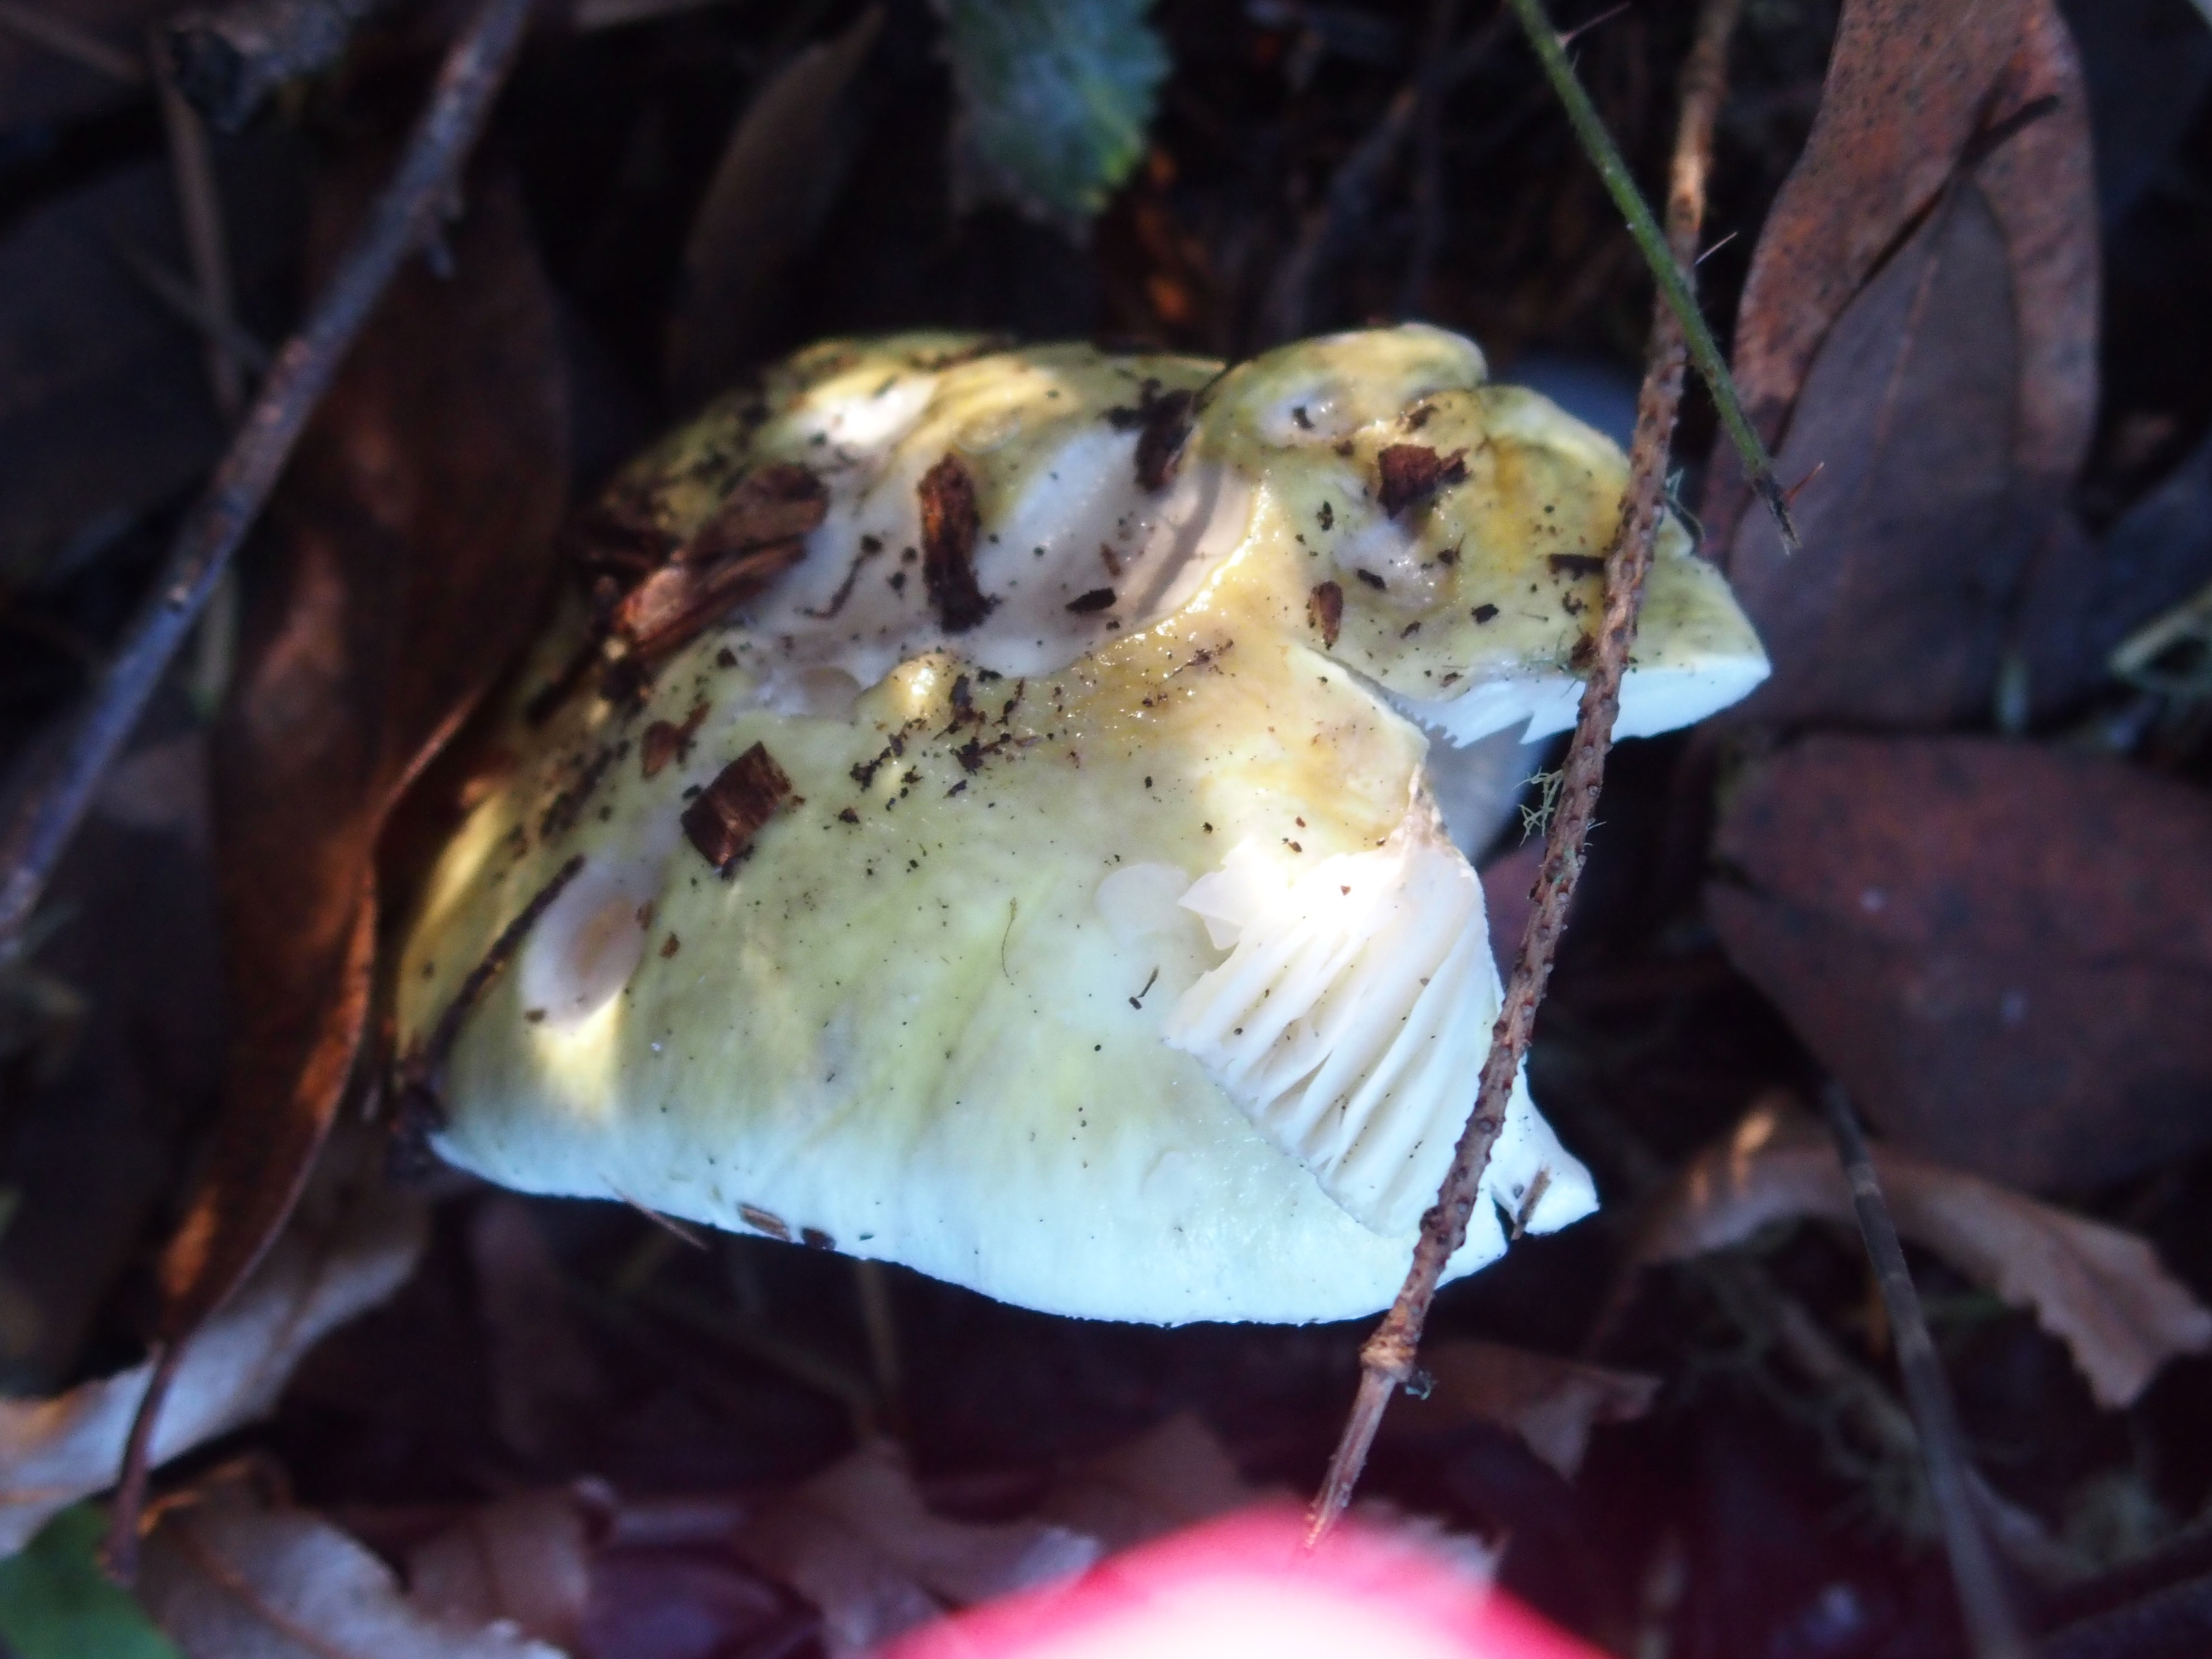
Quantify insect damage
Damage from phorid fly
Pinhead damage from sciarid fly larvae
Notes:
The real reason mushrooms are toxic might not be about microbes. It might be about insects.
Predictions:
If enemy release has occurred:
Less insect damage in CA than Europe

Slide 40
More Writing Tips
Books about writing:
Anne E. Greene: “Writing Science in Plain English”
Joshua Schimel: “Writing Science”
Prioritize readability, not precision
Read work by respected writers
Read some more
Just start writing already
Notes:
Many people recommend Anne Green’s book “Writing Science in Plain English”
I’m personally a big fan of Joshua Schimel’s book, which is marketed specifically towards academics but does SUCH a great job of breaking down how academic writing is formulaic that I think it really helps reveal how formulaic journalism is as well.
I can give you easily google-able tips for writing for the public like “prioritize readability, not precision” or “use action verbs.”
In the end though, what most successful writers say is that to be a better writer, you ought to read work from actual science writers. Just google who the best science writers are, and read what they write.
And then read some more, until you start getting a sense for what sort of writing is successful.
But really you should just start writing yourself, and getting feedback on how to improve your writing.

Slide 41
General media sources
http://www.pewinternet.org/2015/02/15/how-scientists-engage-public/
http://www.nature.com/news/online-collaboration-scientists-and-the-social-network-1.15711
http://sciencecareers.sciencemag.org/career_magazine/previous_issues/articles/2014_02_28/science.opms.r1400141
http://socialnetworkingforscientists.wikispaces.com/General
http://journals.plos.org/plosbiology/article?id=10.1371/journal.pbio.1001535
http://aci.info/2015/02/16/blogs-and-social-media-play-important-roles-in-helping-scientists-engage-the-public/
http://www.elsevier.com/connect/how-to-use-social-media-for-science
http://www.evidentlycochrane.net/open-access-social-media-can-help-science-move-forwards/
http://blogs.scientificamerican.com/science-sushi/2011/09/27/social-media-for-scientists-part-1-its-our-job/

Slide 42
Twitter Sources
http://chronicle.com/article/10-Commandments-of-Twitter-for/131813/
http://www.socialmediatoday.com/content/omg-over-40-twitter-abbreviations-you-should-know
http://blog.getacclaim.com/25-interesting-observations-about-how-academics-use-twitter/
http://savageminds.org/2013/05/08/the-academic-benefits-of-twitter/
Notes:
In 2012, only one in 40 scholars was active on Twitter, which is a shame given how useful can be.
Nearly 90% of academics on Twitter use it for work

Slide 43
Facebook Sources
http://blogs.scientificamerican.com/science-sushi/2011/09/27/social-media-for-scientists-part-1-its-our-job/
http://www.makeuseof.com/tag/group-management-basics-how-to-be-a-great-admin-facebook-weekly-tips/
http://mashable.com/2009/10/07/facebook-groups/

Slide 44
Blog sources
http://aci.info/2015/02/16/blogs-and-social-media-play-important-roles-in-helping-scientists-engage-the-public/
http://medicallabtechnicianschool.org/2010/top-50-biology-research-blogs/

Slide 45
Fundraising
http://experiment.com/stats
https://experiment.com/how-it-works
https://experiment.com/guide

Slide 46
“We love GMOs and Vaccines”
Notes:
Facebook can be really great for outreach and education about science and policy issues.
This is a Facebook group called We love GMOs and Vaccines. As far as I can tell, the whole page is run by a this rather angry dad that has very strong opinions about both GMOs and vaccines.
Last time I checked, over 32,000 people follow this page, so it pops up in my feed a lot. The page participants are mostly pro-science, but sometimes some anti-science trolls step in and hilarious feuds ensue. A Facebook group like this, but with maybe more tact, might be a really great way to teach the public about topics important to LBNL.
But I do think the admins might want to stay anonymous….

Slide 47
But be careful…
Anonymity might be best…
Notes:
Recently, the fellow that runs the We love GMOs and Vaccines got involved in some public name calling, and some organic craft store supposedly tracked him down through his employer, so the guy changed his web presence to be anonymous.
So, be nice out there, and be careful, but know that you can still be very successful even as an anonymous group!

Slide 48
More career opportunities: Popular Science
Notes:
Here’s a good example of how it’s a good idea to be on Twitter BEFORE you publish something: other journalists can find you.
After I wrote the Slate piece, the then-senior editor at Popular Science who covered my death cap story started following me on Twitter. He used to be a food critic and loves trying new foods, and one day he joked about sampling the Death Cap mushroom sometime. A few months later, I read about how mushroom cocktails were becoming a big thing in New York, I asked him if he wanted to try them with me. One evening we traveled around Manhattan, talking science journalism and sampling mushroom cocktails. We had a great time and I wrote up a little review of the evening on my blog. This is a super useful connection to have, which came about because I was on Twitter before I wrote the article.

Slide 49
Science is Writing
Popular writing:
Academic writing:
Inverted pyramid
Readability > accuracy
Flashy > technical
Hourglass
Accuracy > readability
Technical = flashy
Notes:
The structure of popular writing is substantially different, often described as an “inverted pyramid” with the biggest claims at the top, narrowing down to tiny details at the bottom. Compare this to academic writing, which has a more hourglass figure: starting broad, narrowing to details, and then usually broadening to more general implications and broader impacts.
In popular writing, readability is more important than accuracy, whereas in academic writing we favor accuracy over readability,
Popular writing: flashy findings with people-relevant implications are often more important than technical advancements. But in academic writing, technical advancements can be just as important as flashy findings, because we use these techniques on a day to day basis.

Slide 50
Crowdsourcing
Notes:
We can win money in more social ways as well. For example, once you’ve cultivated your gregarious twitter following, you can try your hand at public crowd sourcing. You might recall a Kickstarter campaign from 2013 that raised almost half a million dollars to make glow in the dark plants that could function as bio-street lamps. Some of the project’s success was likely due to their donation perks, which included your very own packet of glow in the dark seeds.

Slide 51
Crowdsourcing
Notes:
There are other fundraising models where the only perk donors receive is updates about your research, such as with the science fundraising company Experiment.com.
Scientists make short videos about a proposed project, write a little bit about how the money would be spent, and if they meet their funding goal, they get the money with VERY little overhead, only an 8% platform processing fee.
For example, then Post doc Charissa de Bekker in David Hughes lab raised almost 5000 dollars to study the zombie ant fungus, Ophiocordyceps.
The proposed budget was to figure out the genes involved in the fungus take-over: cryosectioning, RNA extraction, Illumina runs, etc. She won $5000 to do real science.
I only know about this site because, after my Slate piece went viral, experiment.com contacted ME, saying that they could tell I have a knack for science communication and they would love for me to start a campaign with them. The backers have expressed an interest in mycology projects, which is great news for me, but if you tell a fun story, and tell it well, you can get pretty much anything funded.

Slide 52
Crowdsourcing
Notes:
Honestly. You can totally earn small pots of cash for more controversial work, like genetic engineering projects. I went to Experiment.com the other day and browsed their funded projects. Here are two funded GMO projects side by side, so don’t worry that the public isn’t interested in what you’re doing! This can be a great way for a beginning scientist to get money for a small project. And because most the backers aren’t scientists, it can be great for ideas that are a little too risky for government funding agencies, or for gathering preliminary data before applying for something larger like the NSF DDIG or whatever.

Slide 53
Crowdsourcing
Notes:
What’s really cool is that the Experiment.com website does a great job explaining how to run a successful campaign. They walk you through how to design a bite-sized project, what sorts of projects do well, how to target your audience. Then it goes onto the details of how to launch a successful campaign, with whole pages covering project budget, goals, banner image, etc. Then they also have advice on how to use social media to advertise your campaign, designing stretch goals, and if you win how to keep your funders up to date on your progress, and more.
Ecology is relatively cheap, so even if these grant amounts are too small to be worth your time to launch a campaign, I highly recommend reading through these tips. The folks at Experiment have a lot of experience telling stories, and you could pick up some very valuable communication skills.

